Slide 1
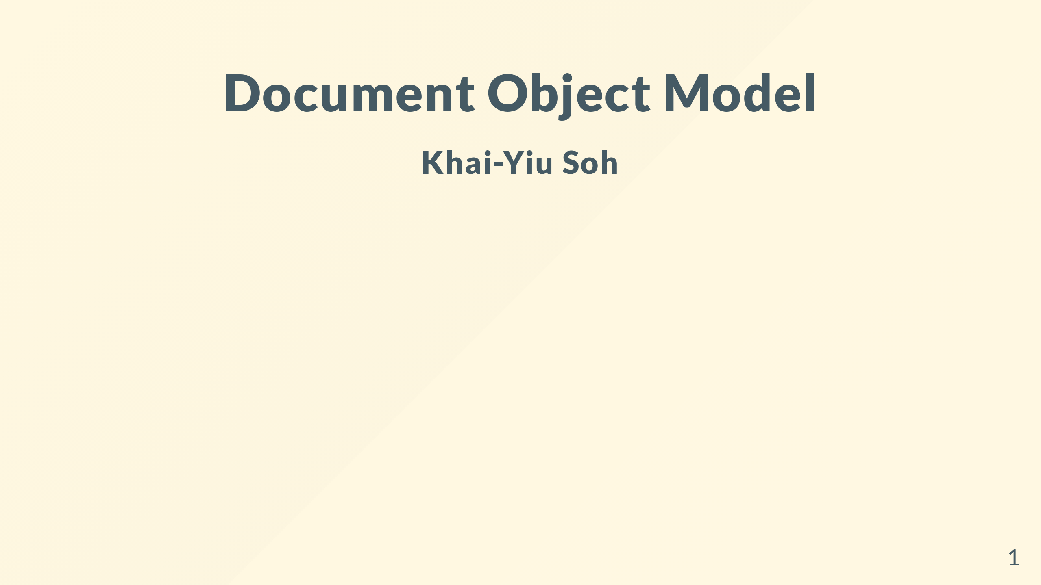

Slide 2
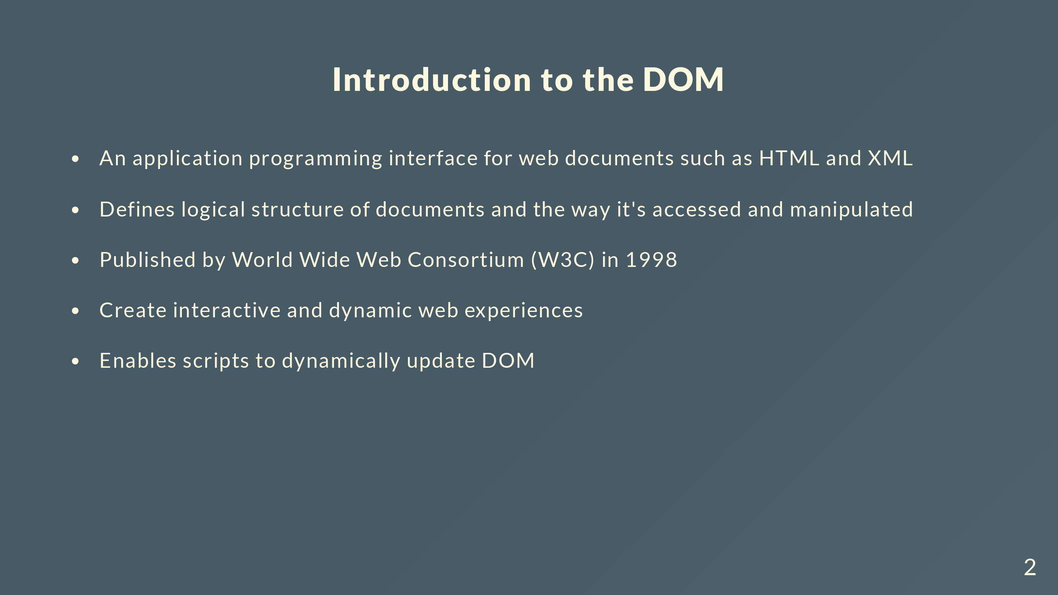
Notes:
The introduction of the DOM significantly changed web development by allowing languages such as JS to dynamically update web pages
Which allowed people to transition from static web pages to a move interactive experience

Slide 3
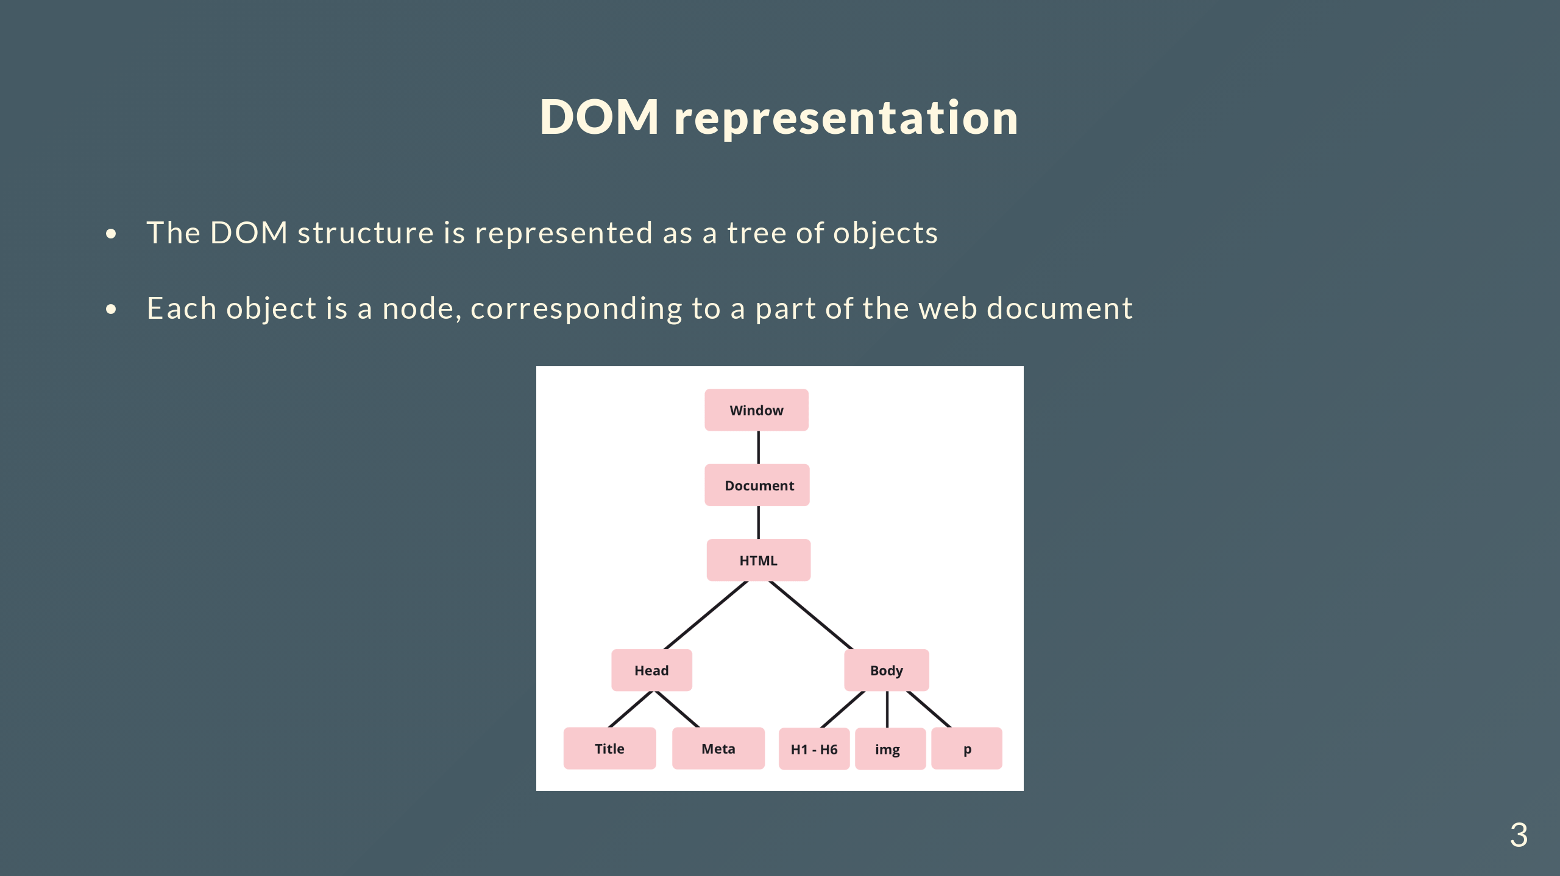
Notes:
We have the global window object which represents the browser tab

Slide 4
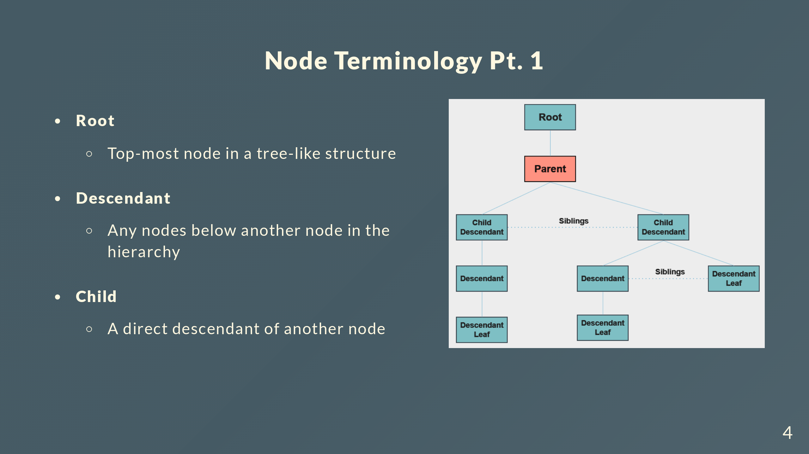
Notes:
I’m just going to go through some basic node terminology
The example on the right will display the type of node relative to the highlighted parent node

Slide 5
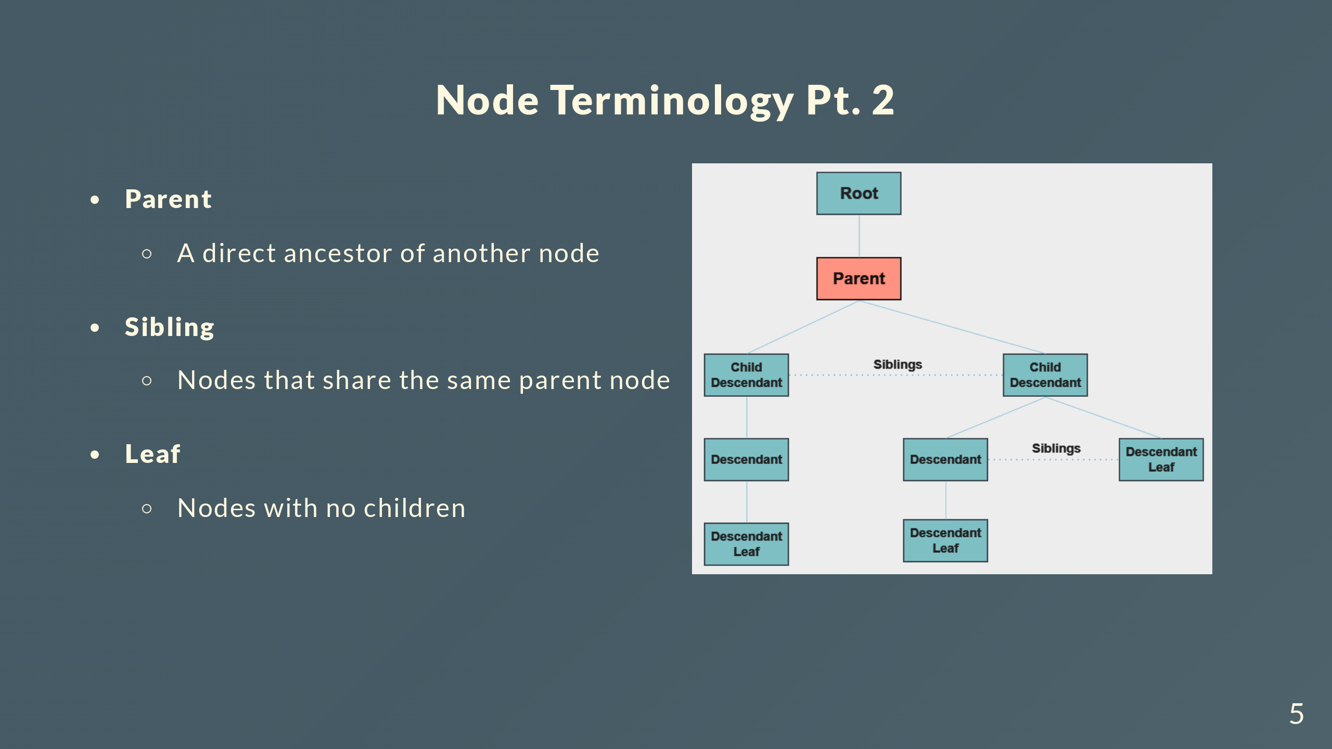
Notes:
There are 2 sets of sibling nodes, each diverging from a common node
Leaf nodes are basically the bottom most node in each branch

Slide 6
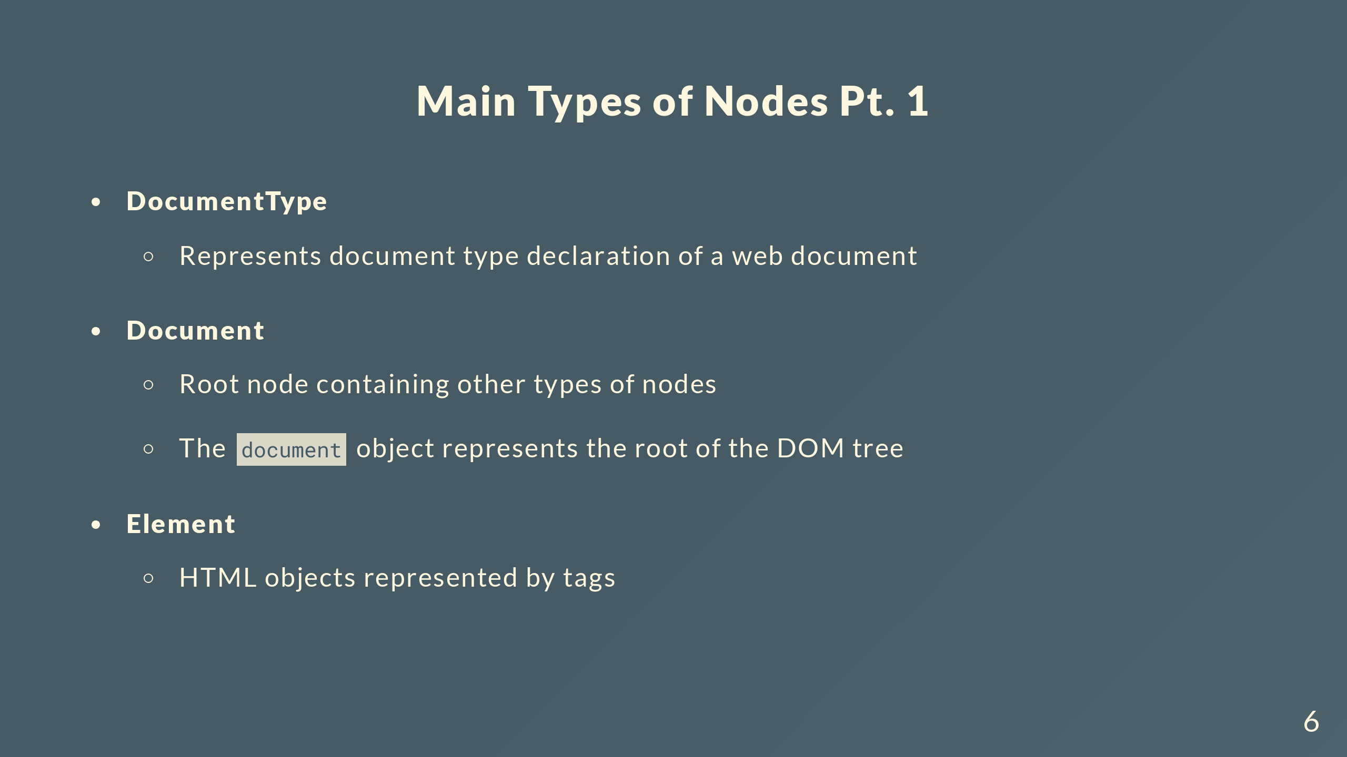
Notes:
There are 11 types of nodes in the DOM but you will encounter mainly 6 of them
The !DOCTYPE html declaration is represented as a DocumentType node
The document object itself is a document node and represents the root o the DOM tree

Slide 7
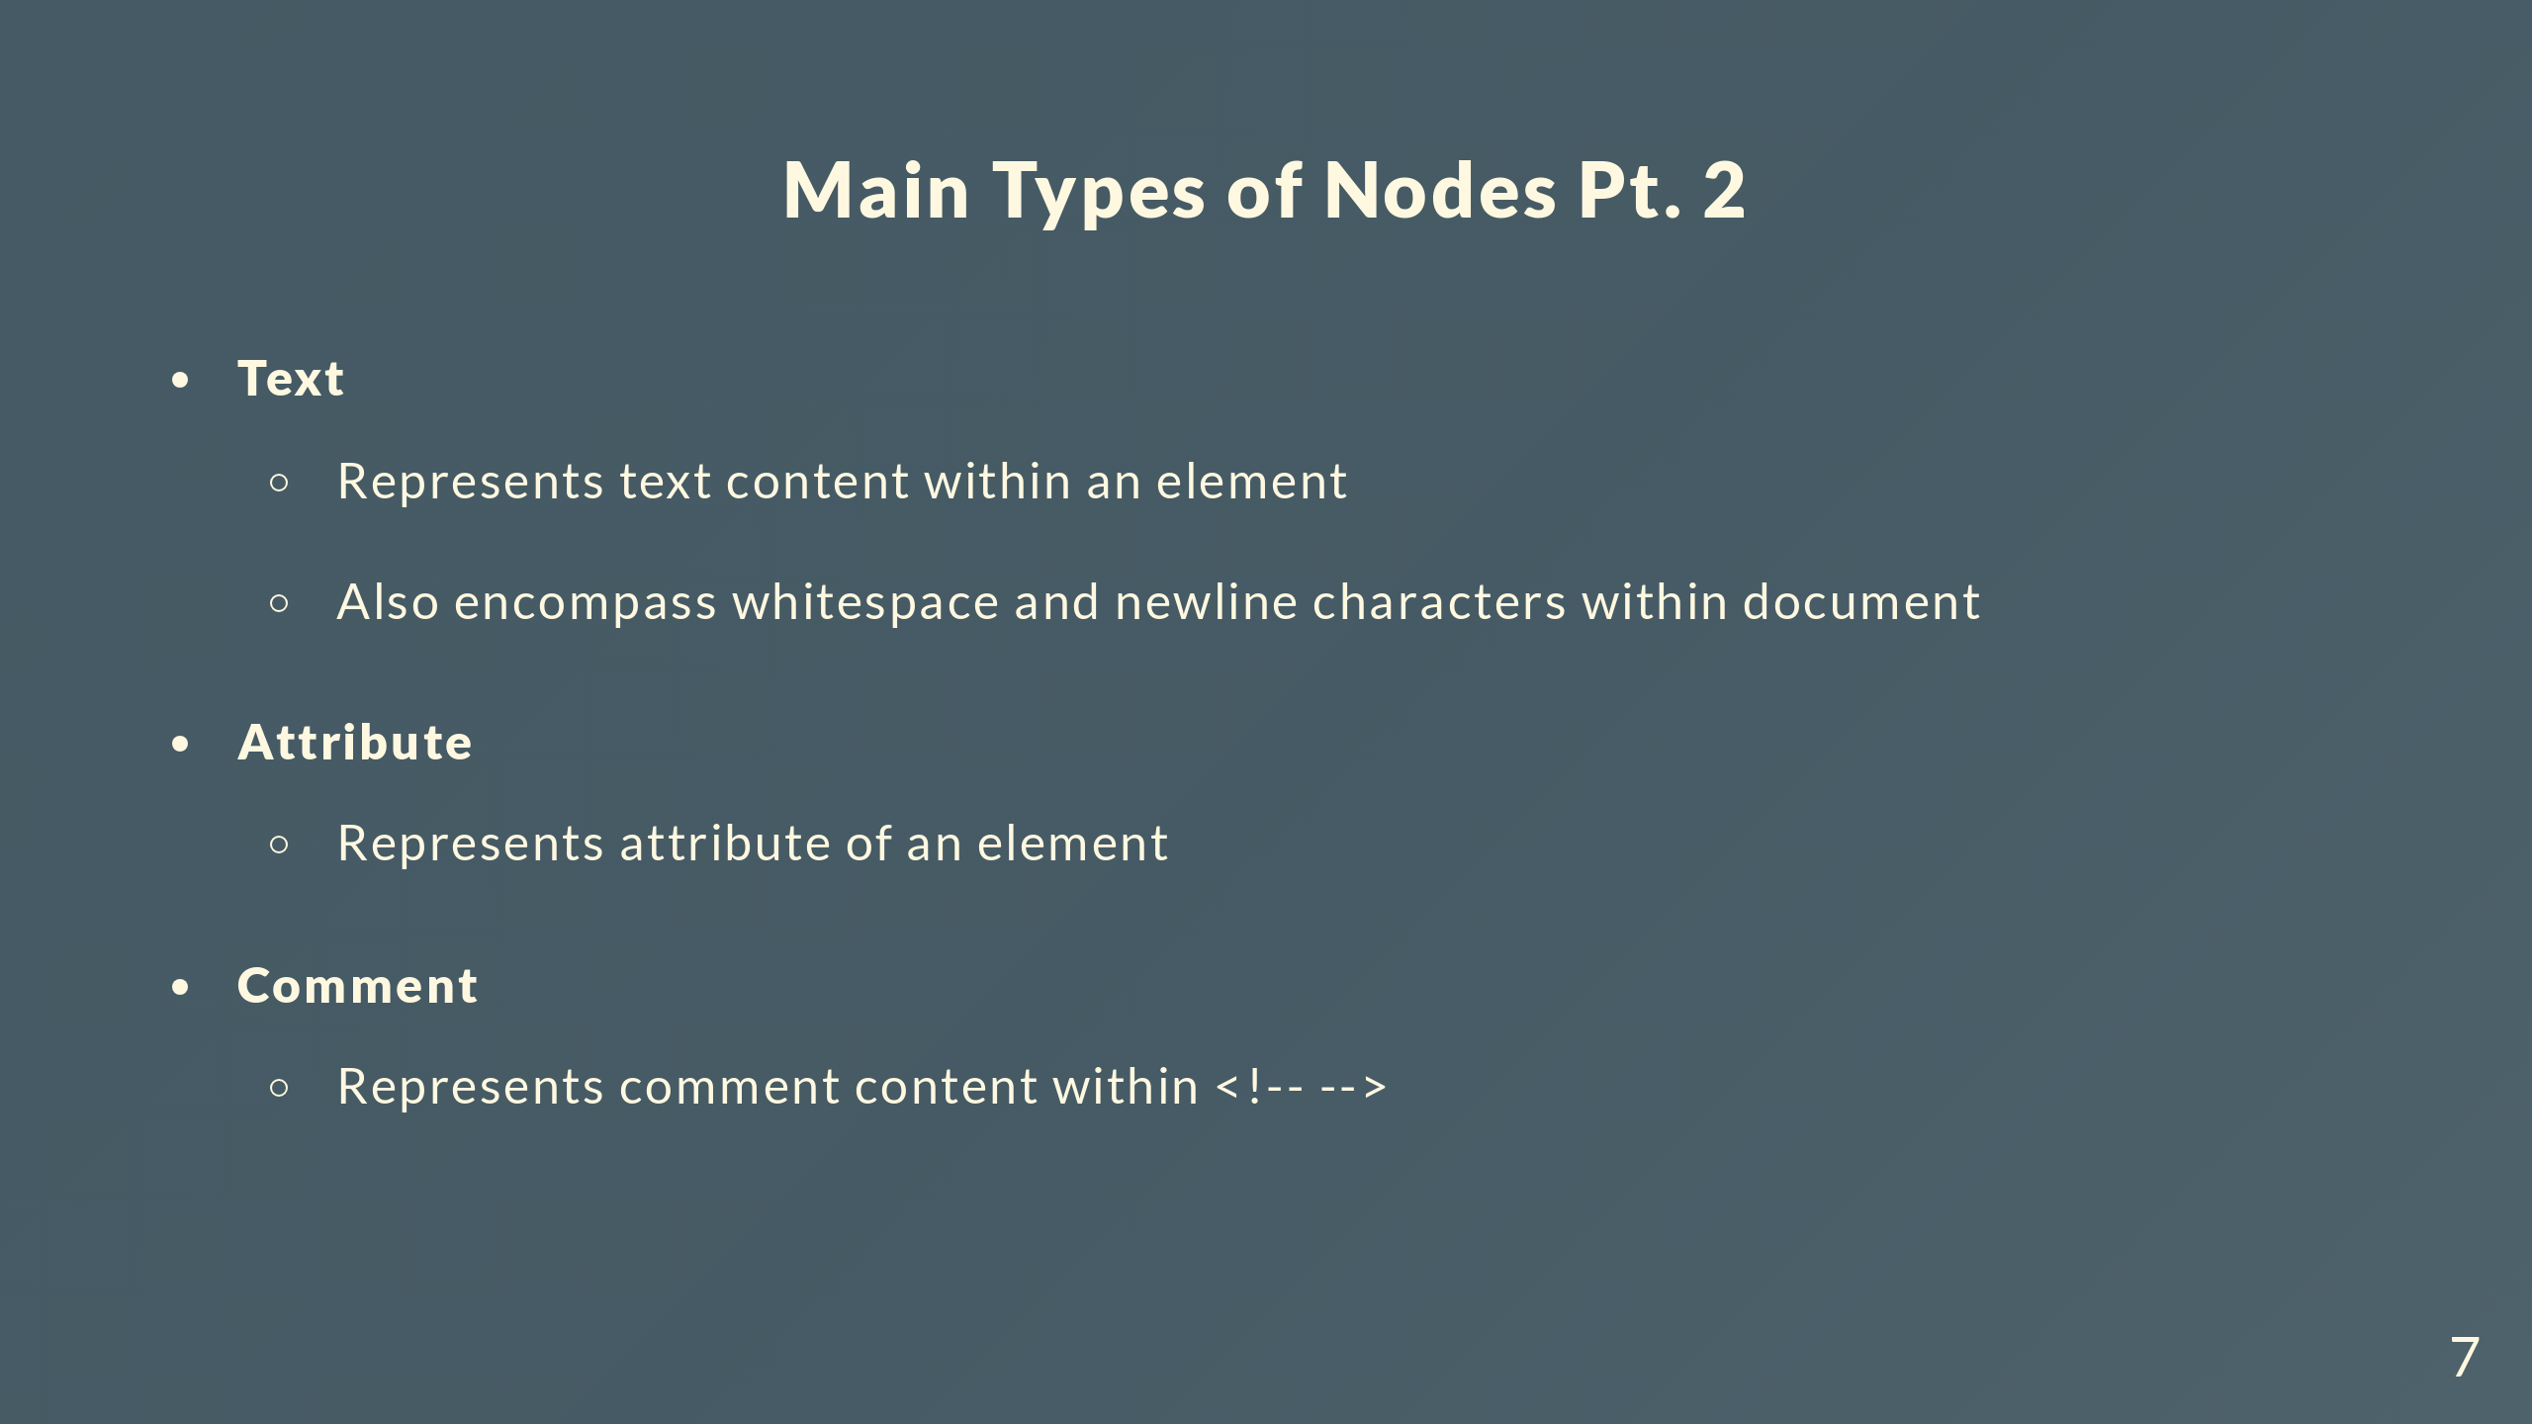

Slide 8
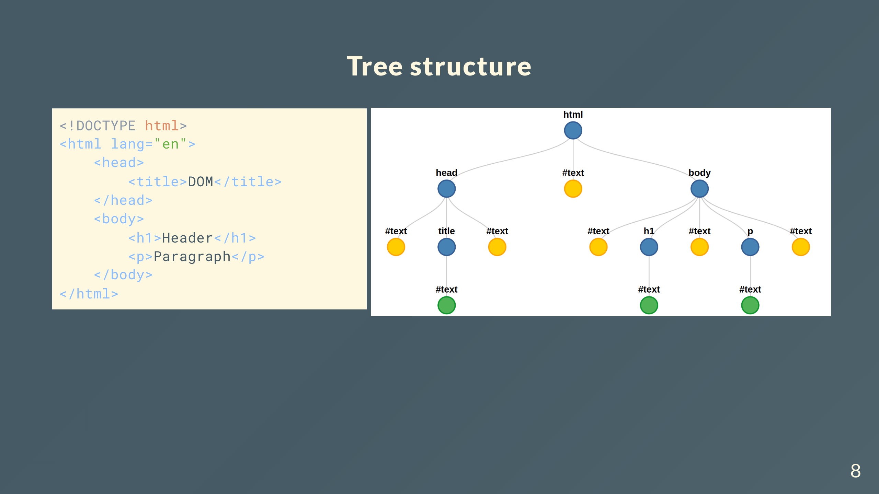
Notes:
You will notice there’s more text nodes in the tree than you’d expect

Slide 9
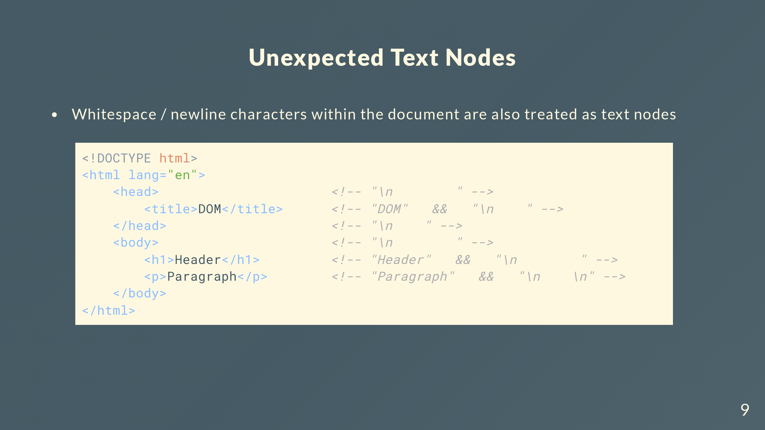
Notes:
So for the example below, you’d think there’s only 3 text nodes
But consider the space between the opening head tag and opening title tags
There is a newline and an indentation of 8 spaces, the DOM treats this whole string as a text node

Slide 10
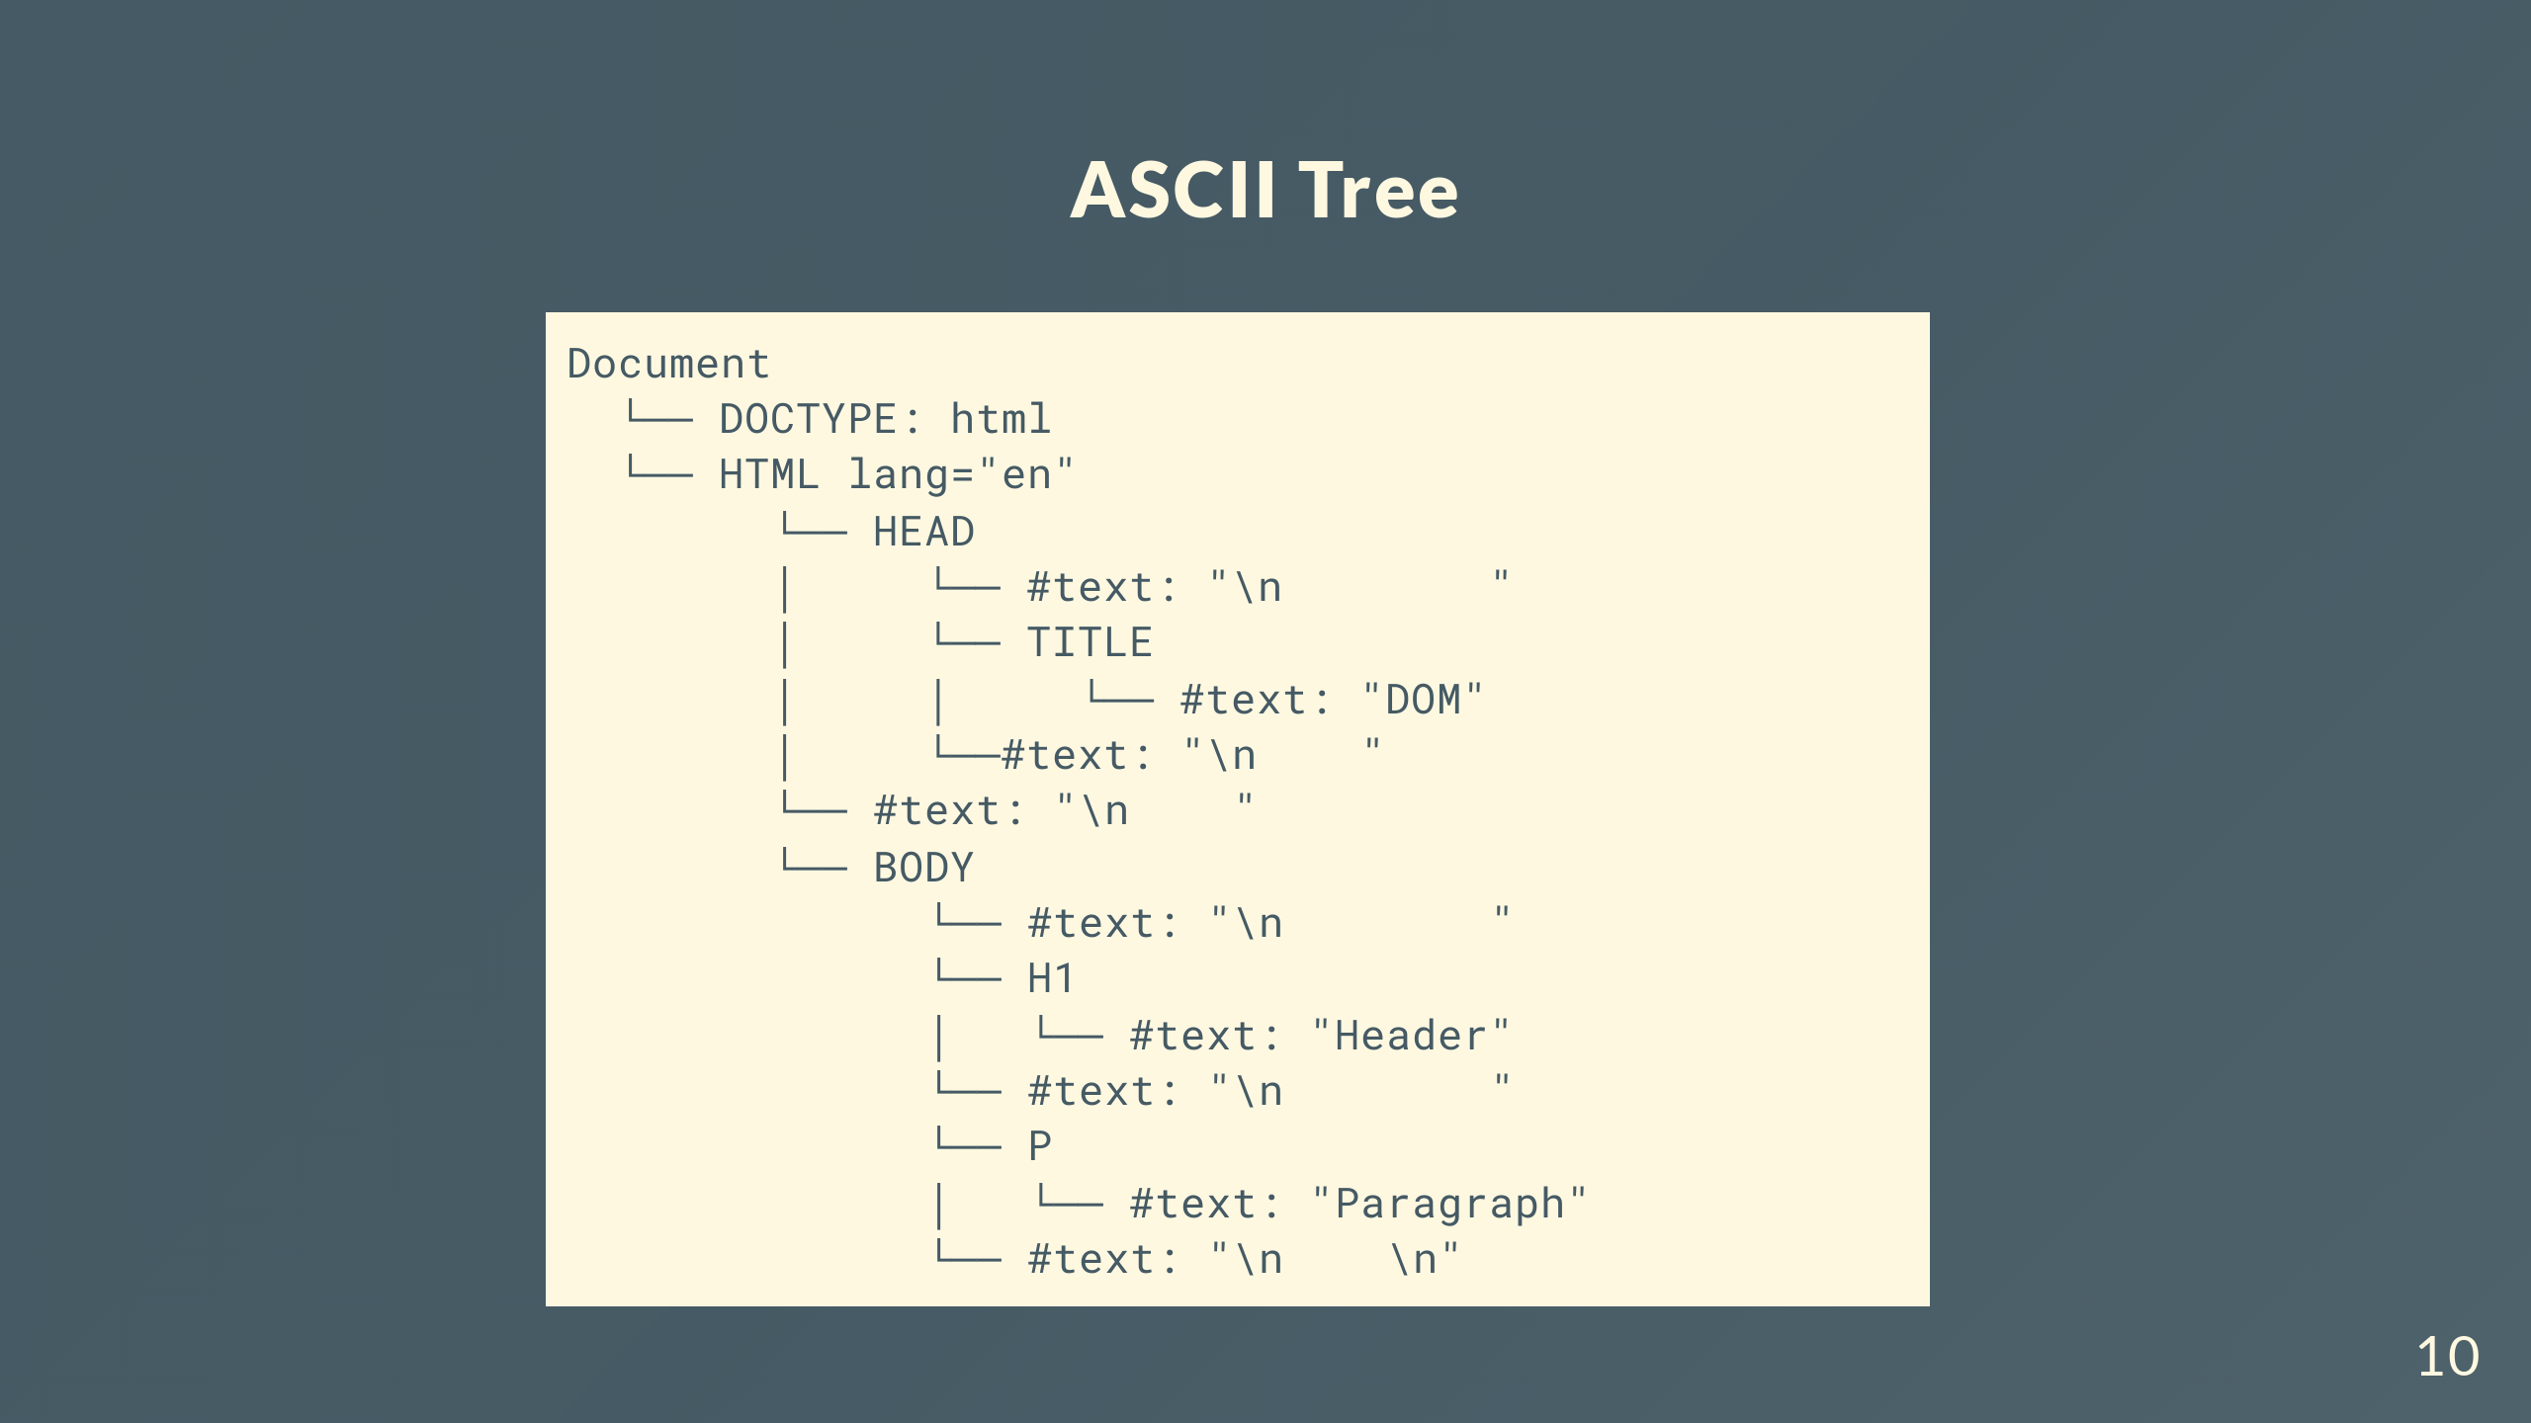
Notes:
Here’s another tree diagram in ASCII format, hopefully you can see a bit clearer the structure of the whole document
The document node contains the document type node and the HTML structure

Slide 11
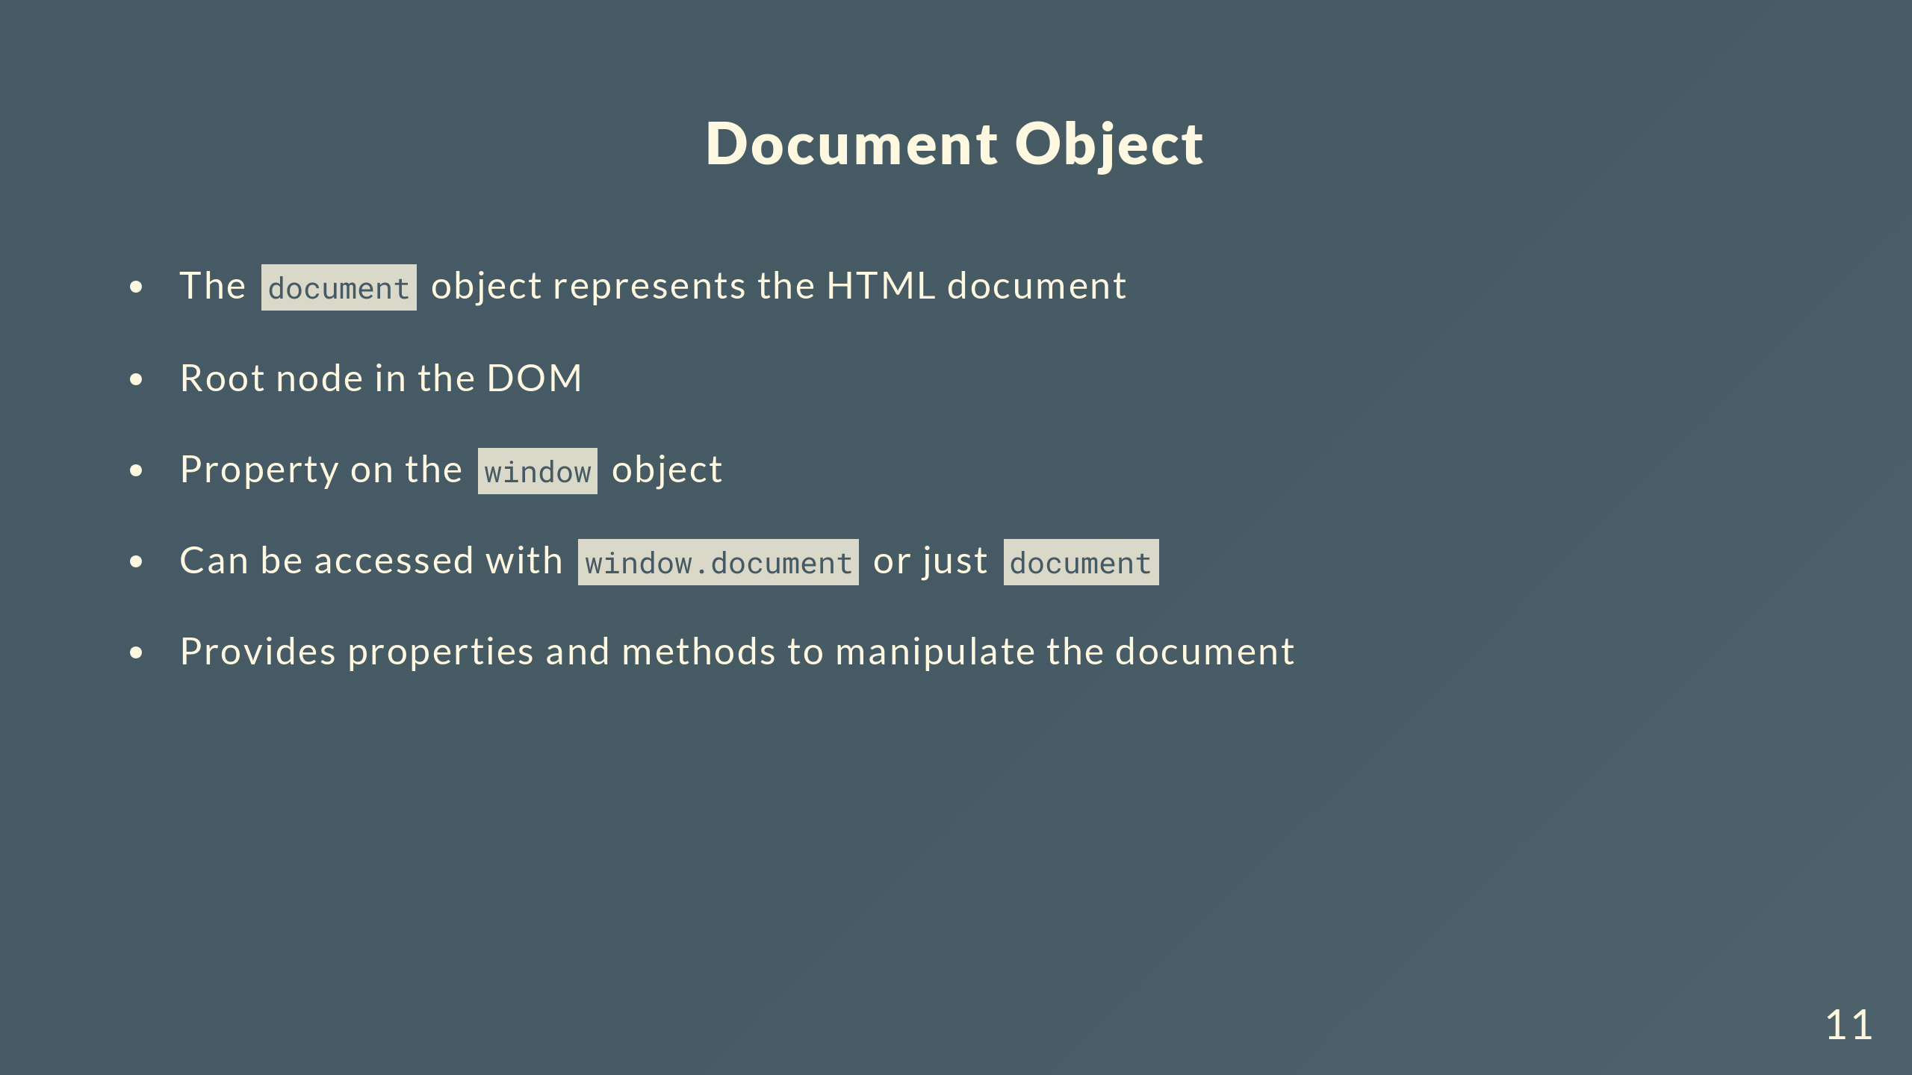
Notes:
To give a brief summary on the document object

Slide 12
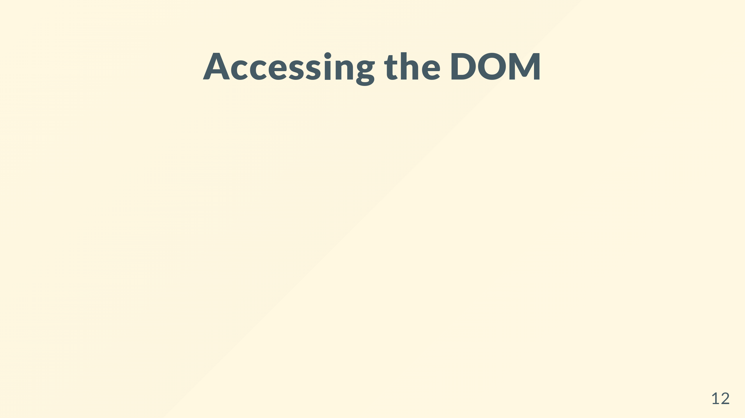

Slide 13
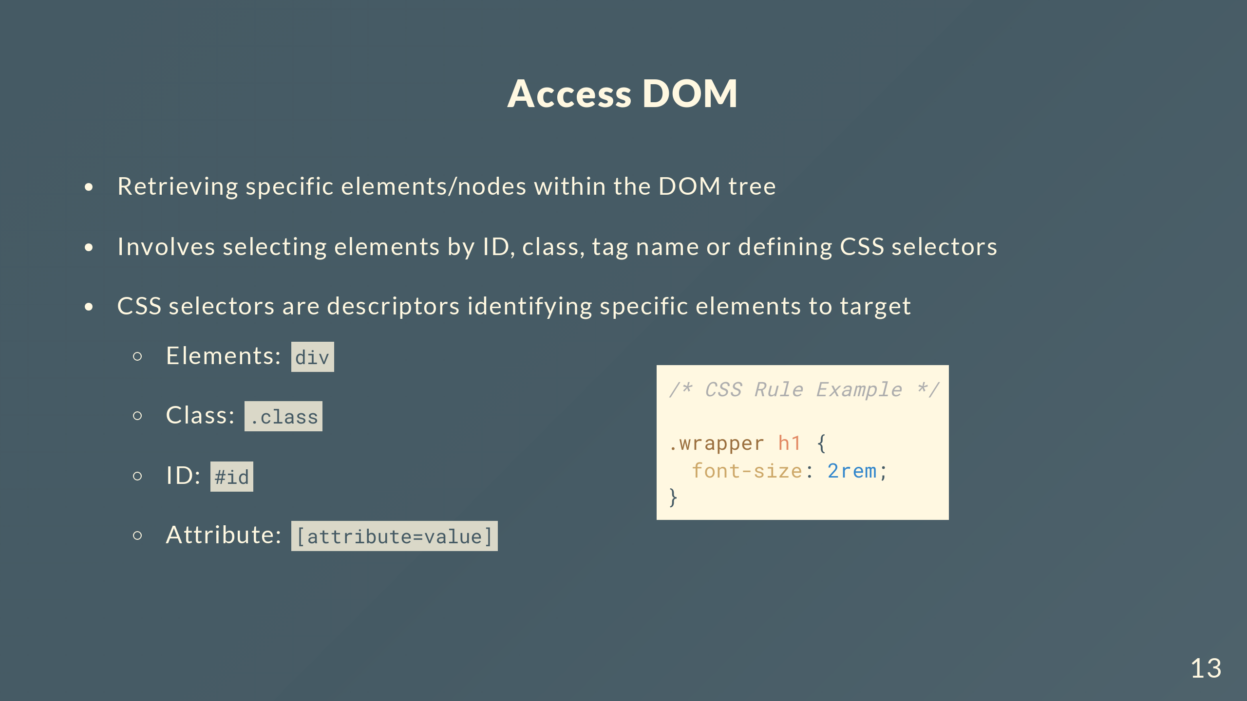
Notes:
To refresh the basics of CSS, that whole block of CSS on the right is called a rule
Rules are made of selectors and a set of declarations
The selectors in this case are .wrapper h1, and that’s the only part we’re concerned with for finding elements
Then, there’s some basic syntax showing how to query with different types of data

Slide 14
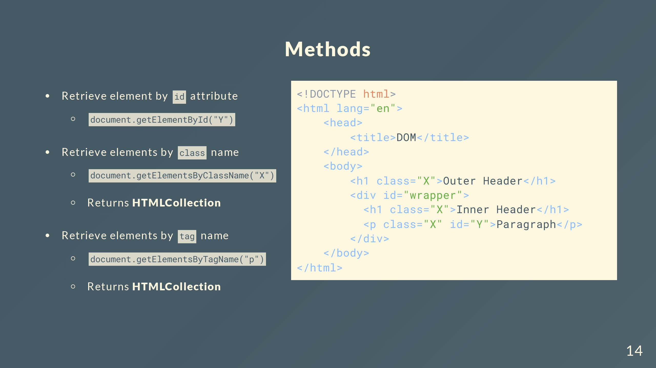
Notes:
Return the outer, inner headers and the paragraph as a HTMLCollection
It’s not an array but you can still access the elements like an array using indexes

Slide 15
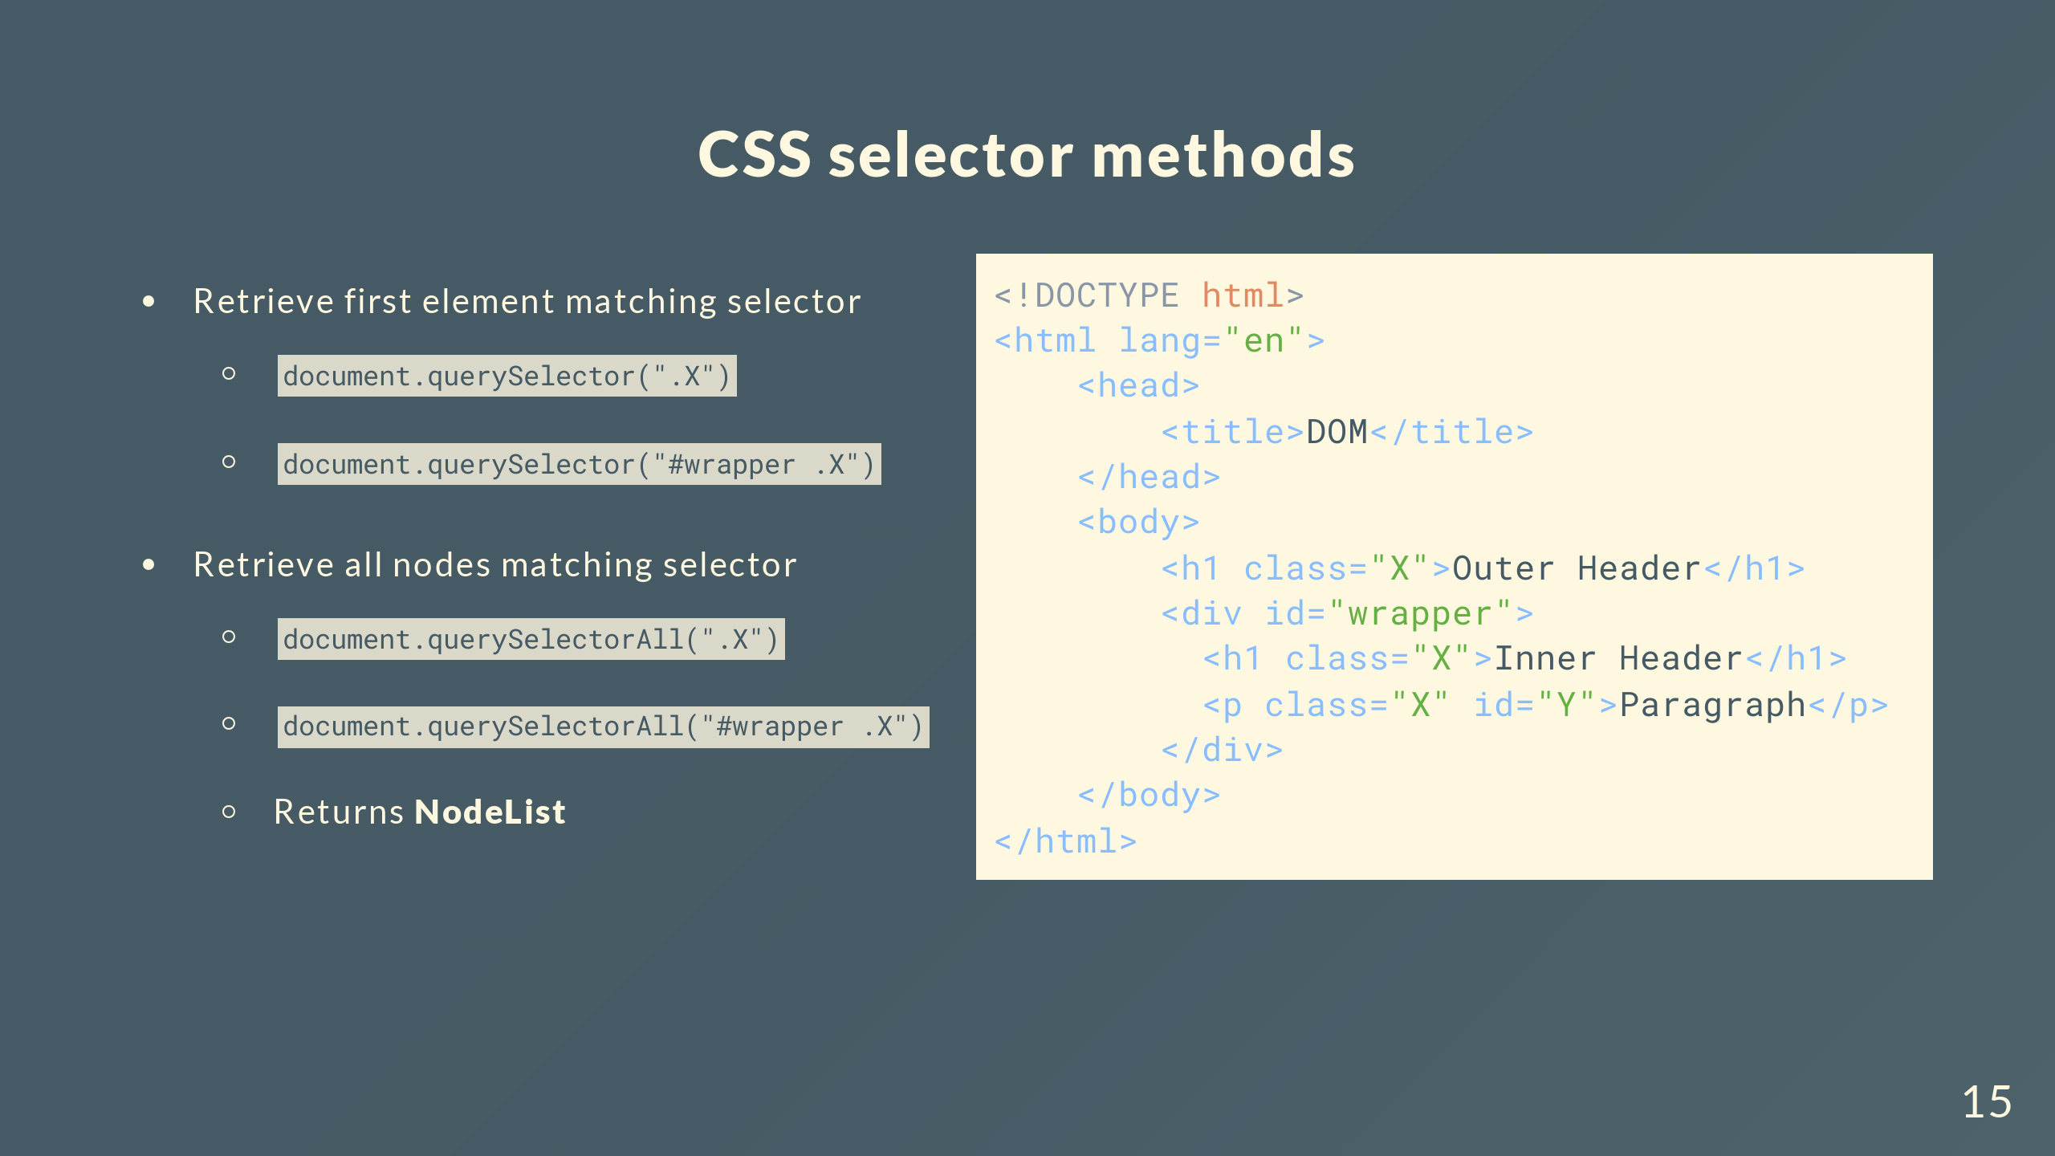
Notes:
For the second example, the selector is #wrapper .X which searches for elements of class X which are descendants of an element with the id wrapper
Returns a NodeList which is different from an array and HTMLCollection

Slide 16
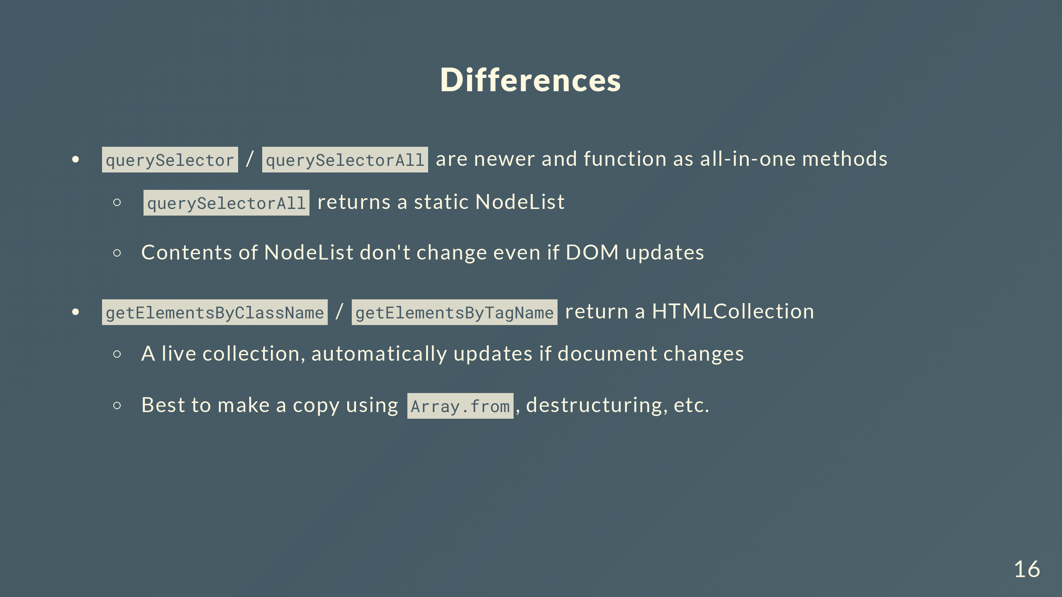
Notes:
So what are the differences between all these methods?
More versatile, we mentioned that CSS selectors can search by tags, classes, ids, attributes, etc.
What static means here is when you use the query method, the returned NodeList doesn’t change even if the DOM updates
That means making any relevant updates to the DOM would automatically update the data even after you’ve invoked the method

Slide 17
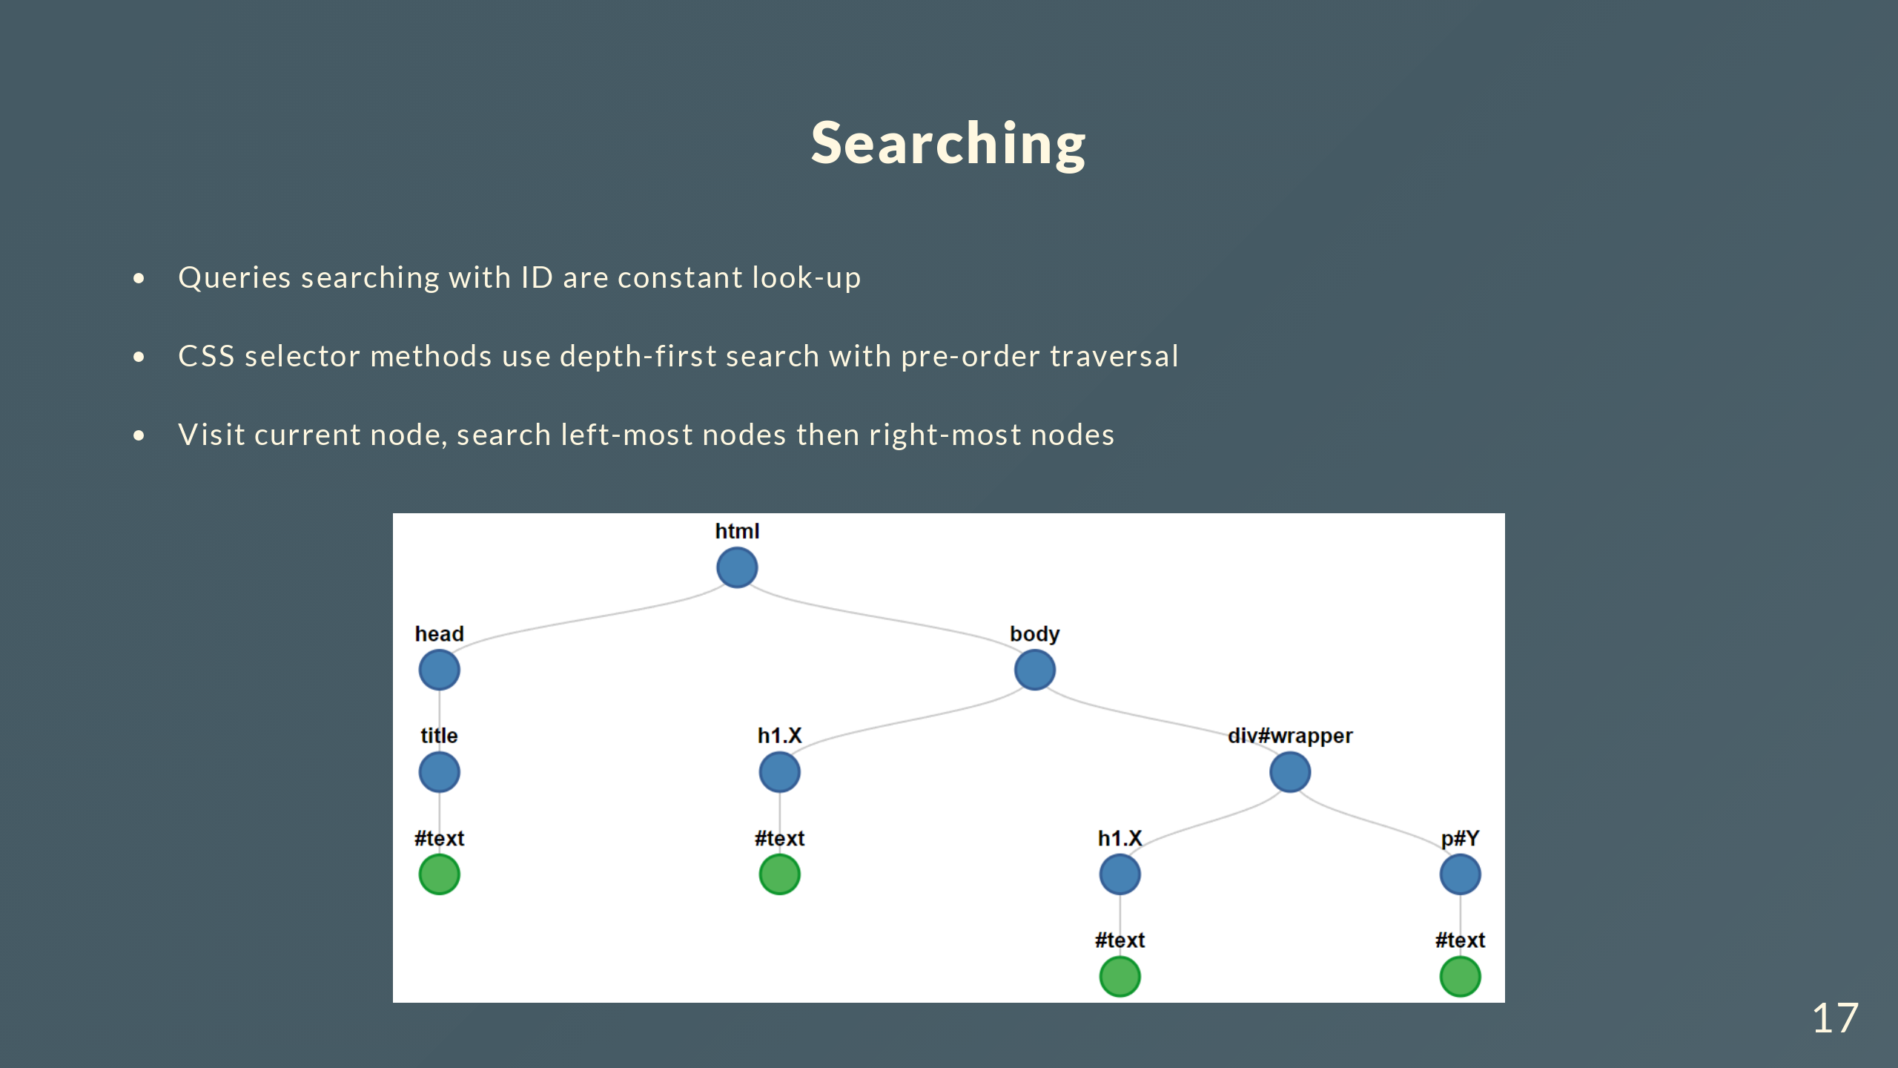
Notes:
Queries searching with ID are constant look up because the DOM maintains a table of unique IDs

Slide 18
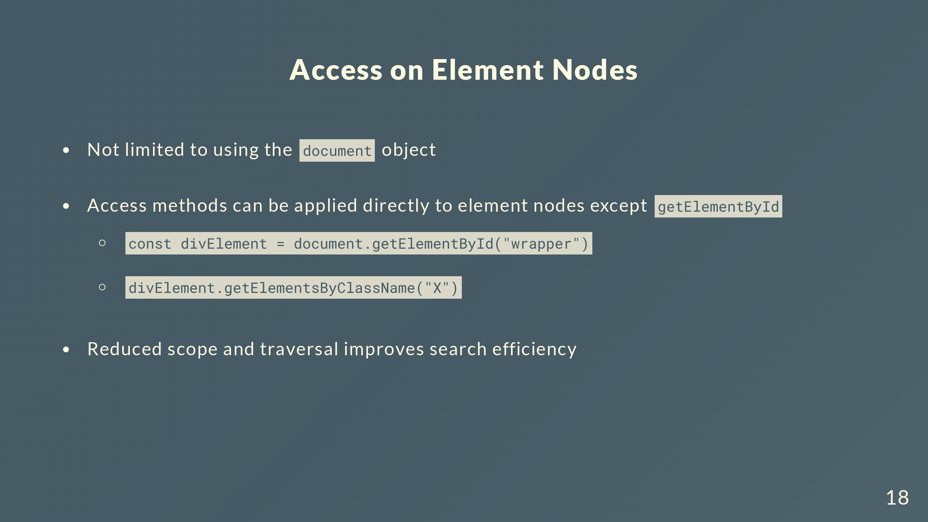
Notes:
Only a method on document object since ID values should be unique throughout the document, don’t need it implemented on any other node types

Slide 19
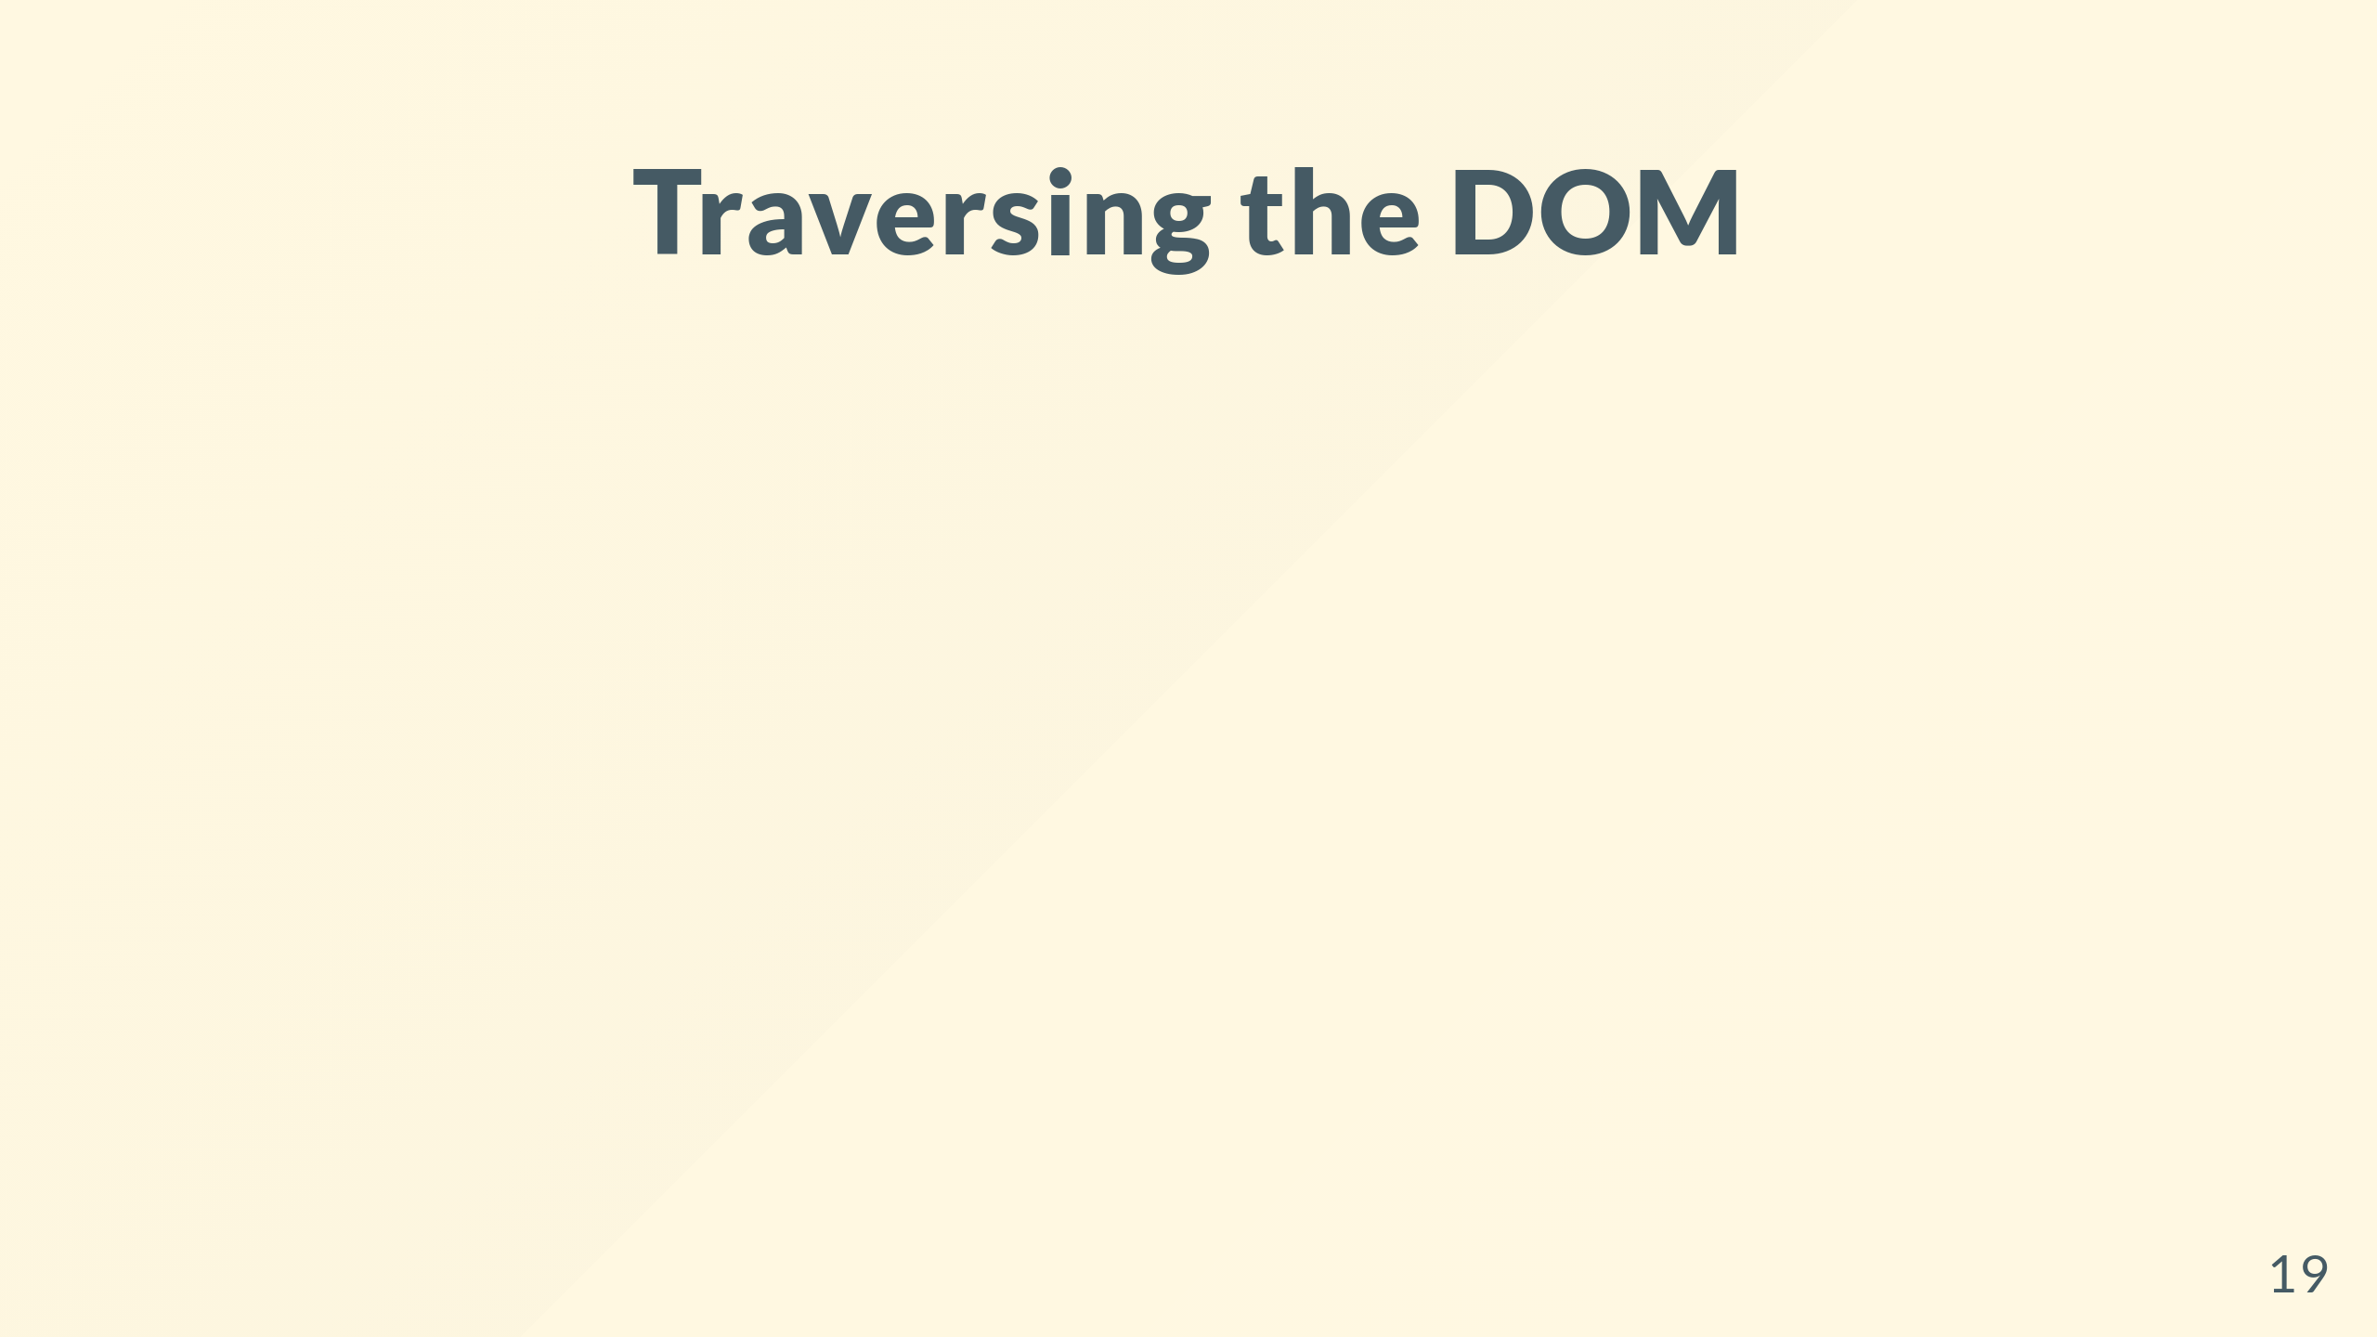

Slide 20
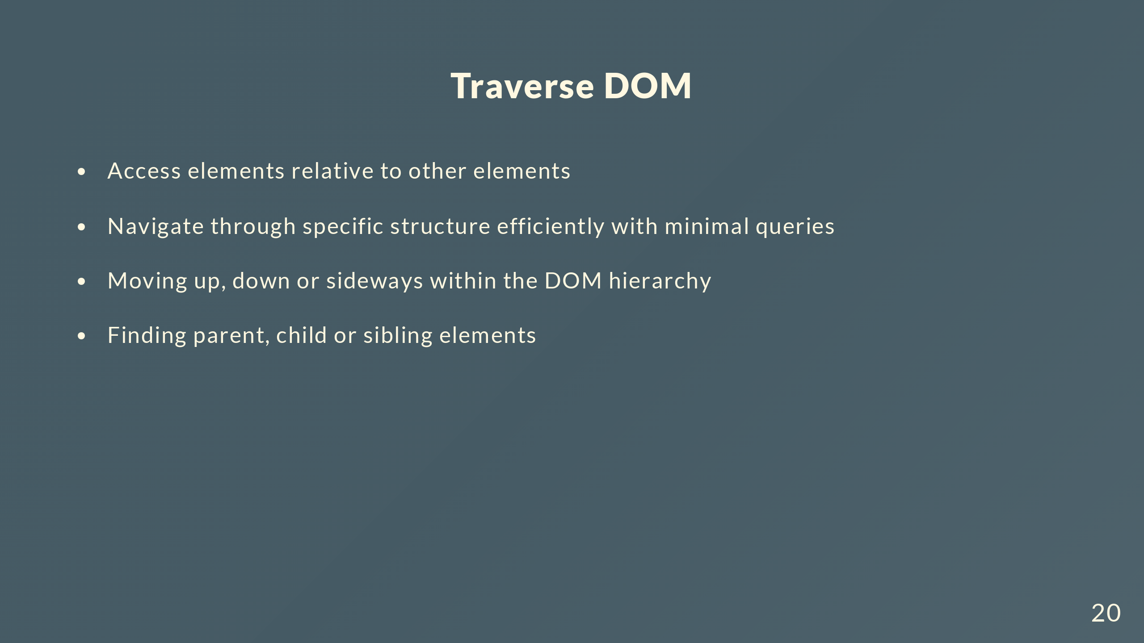

Slide 21
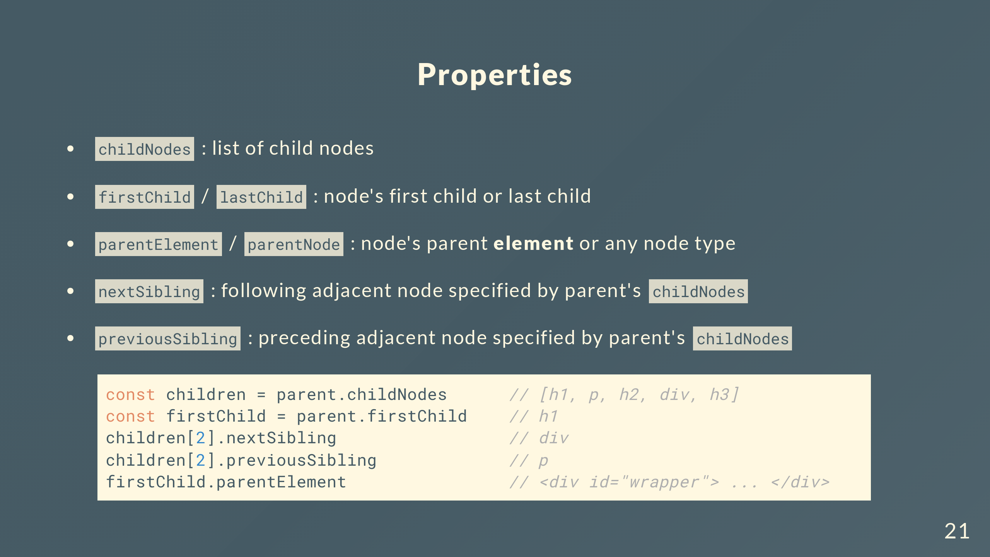

Slide 22
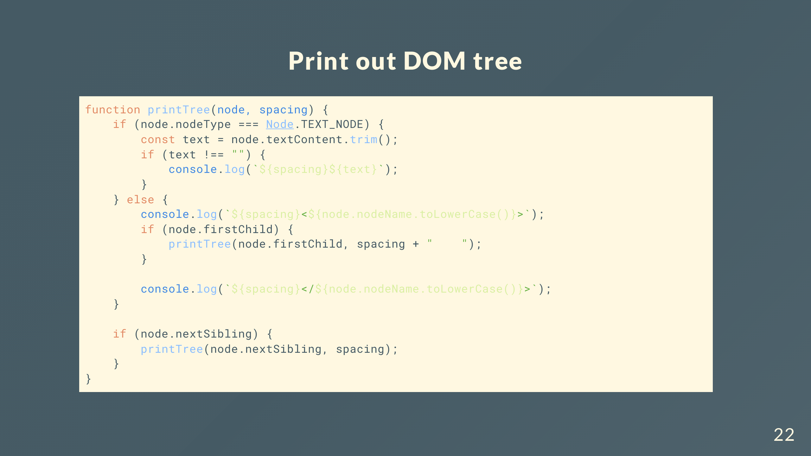
Notes:
We can encounter unexpected text nodes, here we use the trim method to filter them all out, printing only text nodes within elements
The else block handles element nodes, displaying the opening tag first. Then we check for any potential child nodes and handle them first, spacing also increases to indent different levels of the tree.
Then we finish the closing tag and repeat the process for siblings, which are on the same level

Slide 23
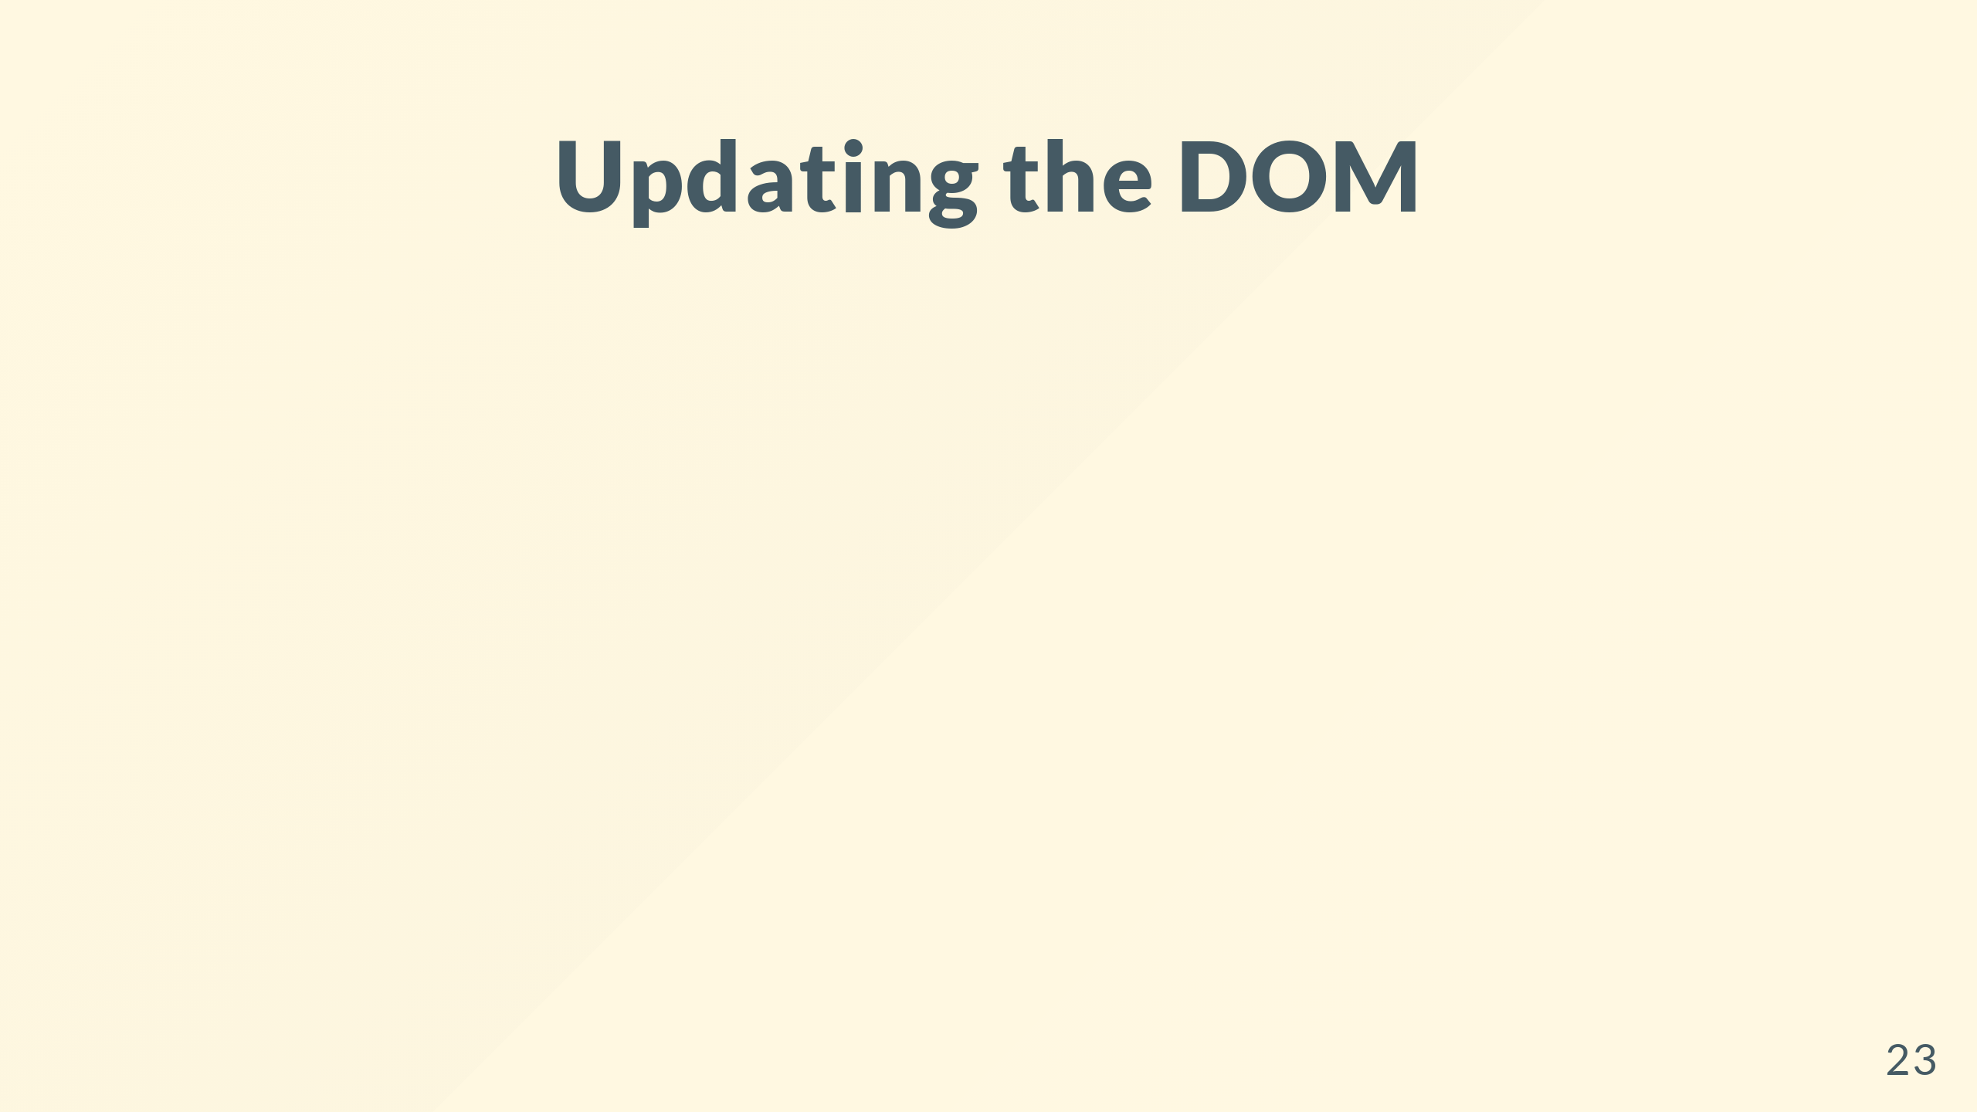

Slide 24
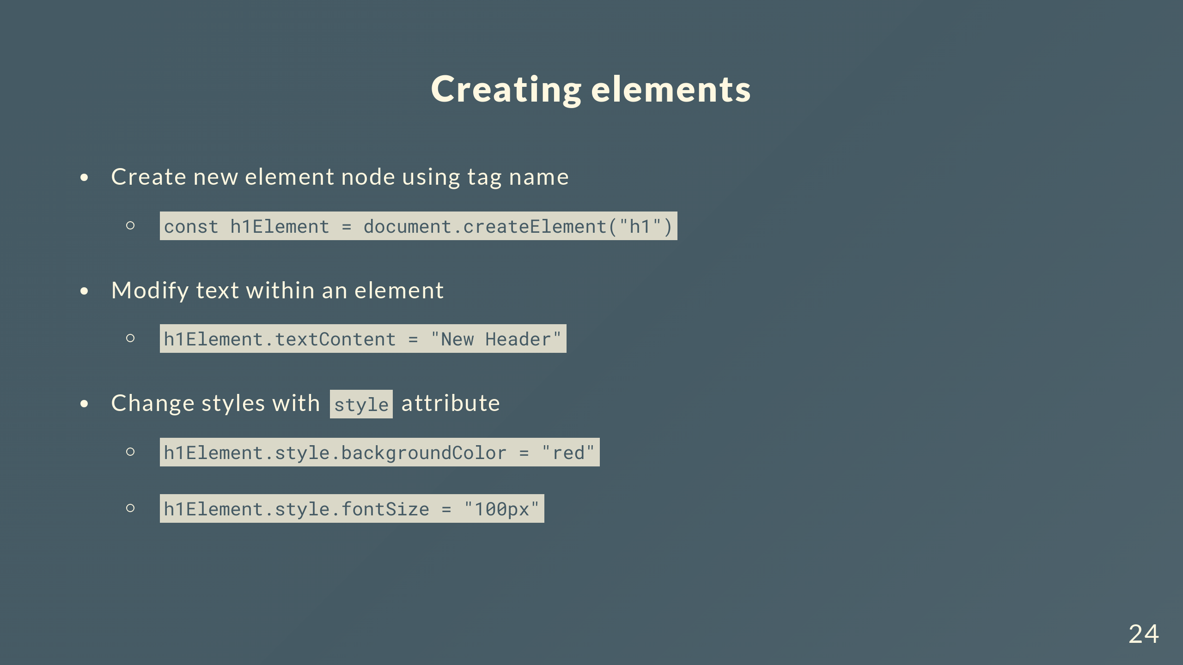

Slide 25
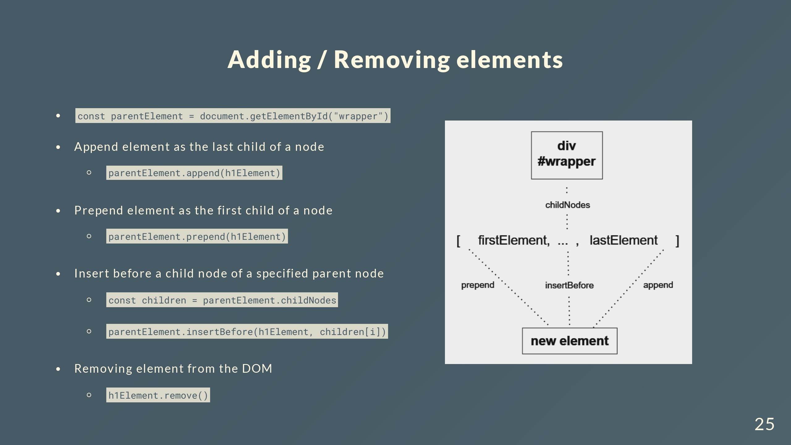

Slide 26
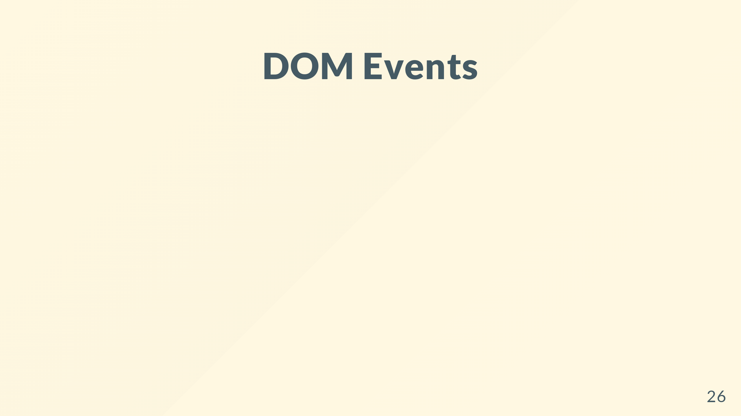

Slide 27
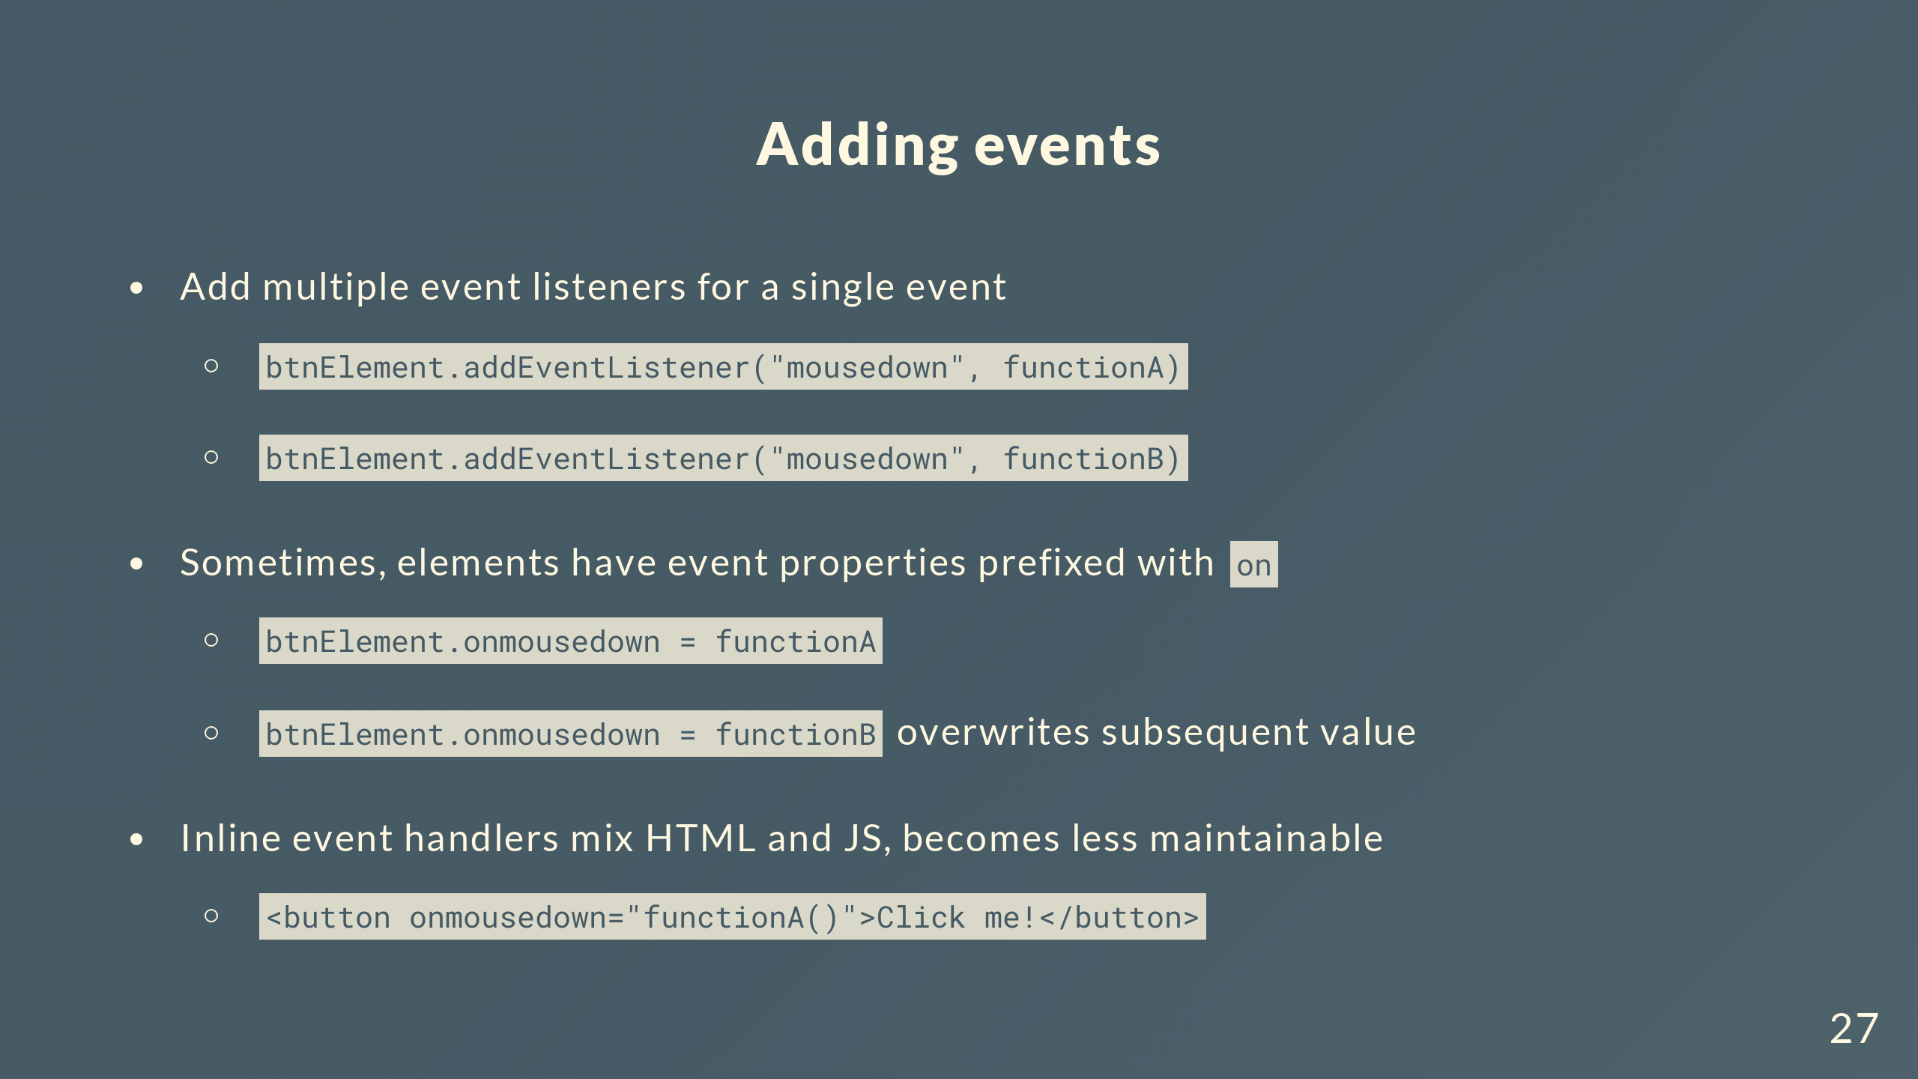
Notes:
There are basically 3 ways to add event listeners
The 2nd method uses event properties which some elements have
Here we have a simple example of functionA being invoked, but you can run more complex JS code within the quotation marks

Slide 28
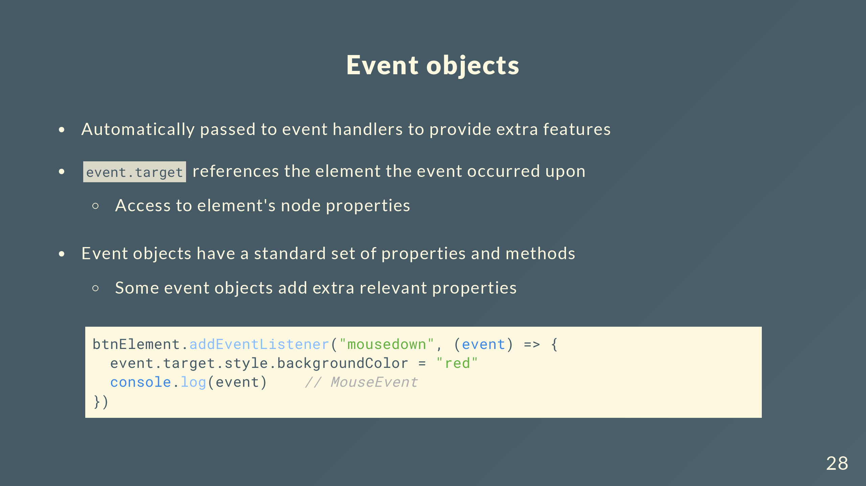
Notes:
When you write handler functions, you can use an event object which is automatically passed in to provide extra features
Give you access to the element node’s properties and methods discussed in previous sections
There are different types of event objects for each event, but most have a standard set of properties and methods
Keyboardevent object has keys
Mouseevent object has a similar property buttons

Slide 29
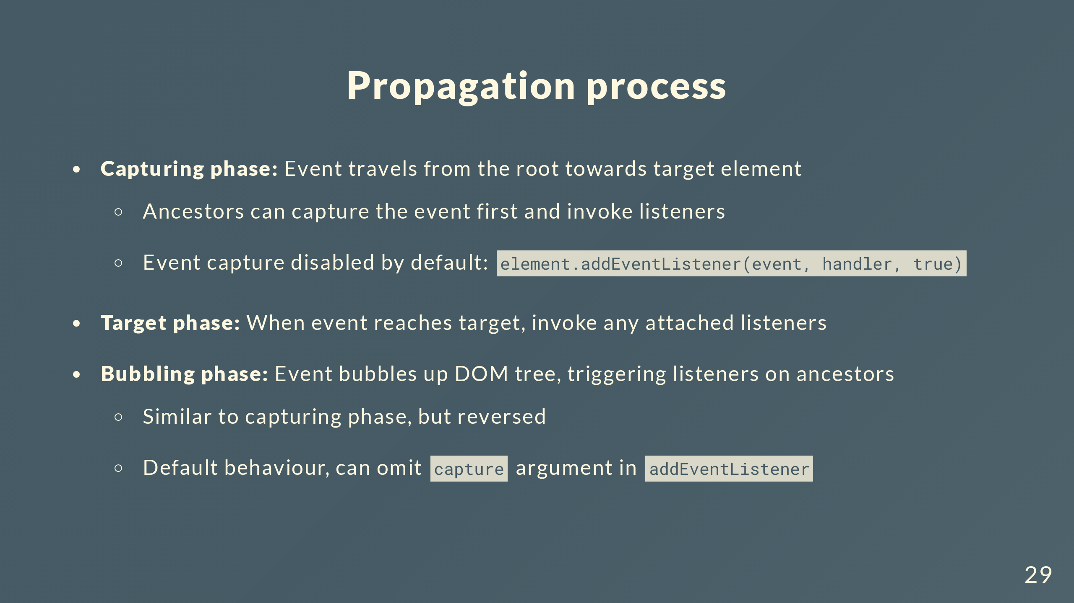
Notes:
By default, event handling at the capturing phase is disabled unless you pass a 3rd parameter that’s true to addEventListener

Slide 30
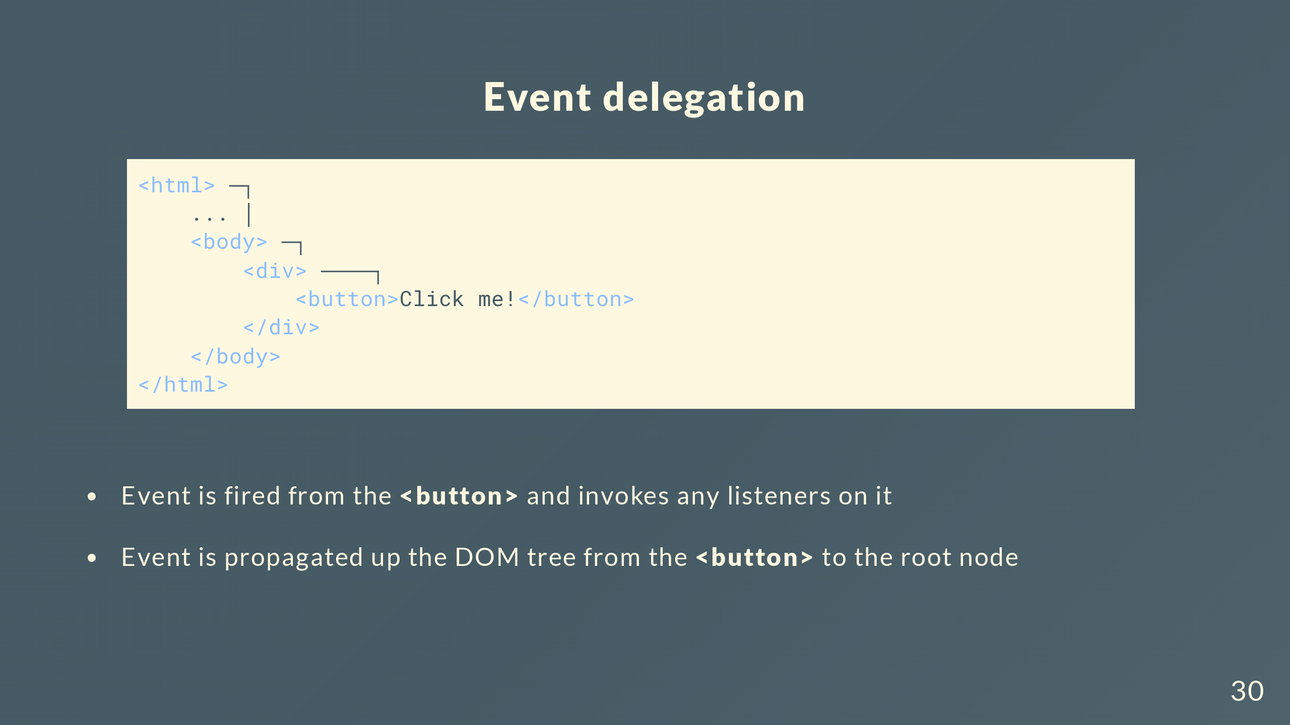

Slide 31
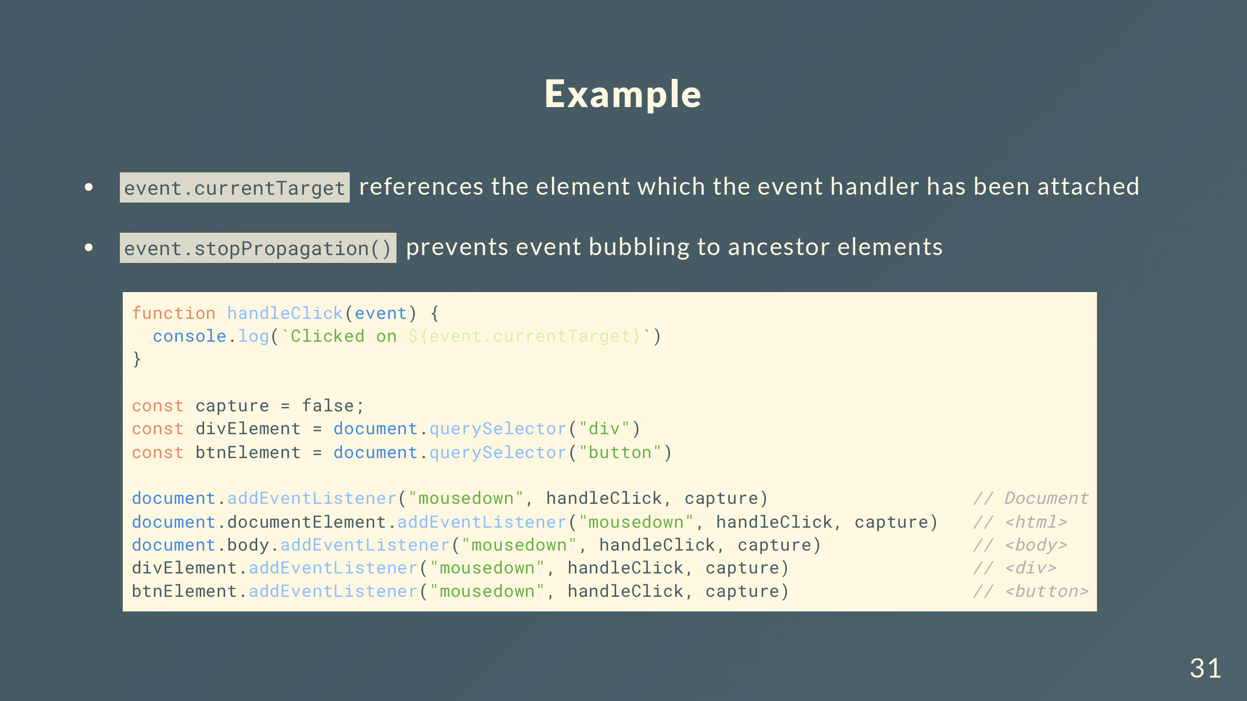

Slide 32


Slide 33
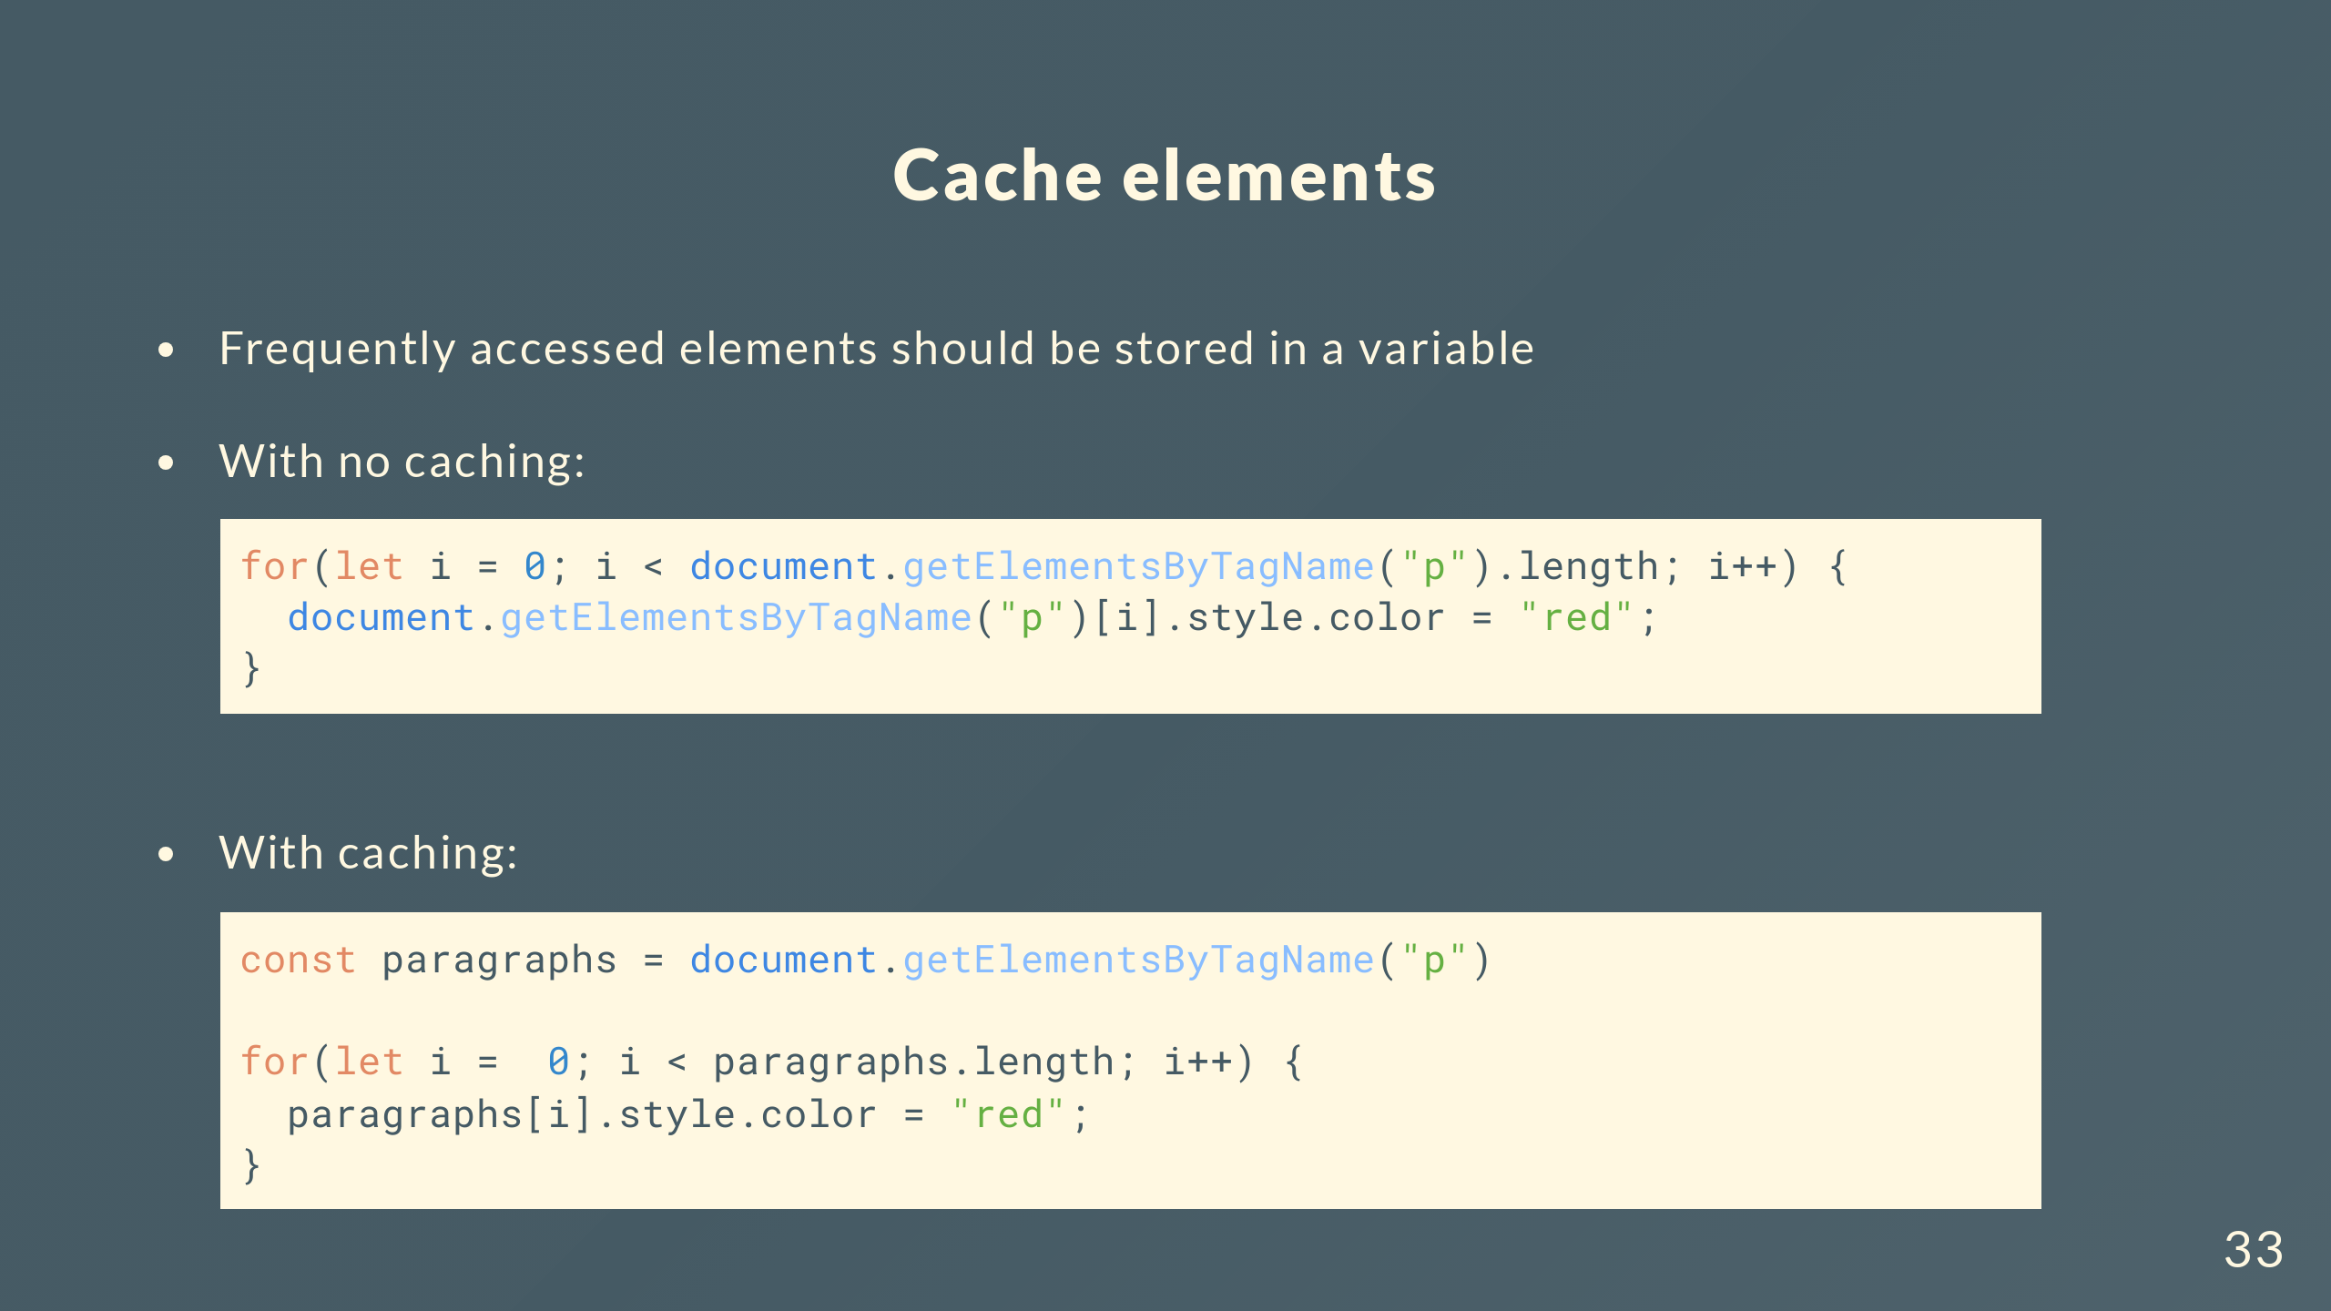

Slide 34
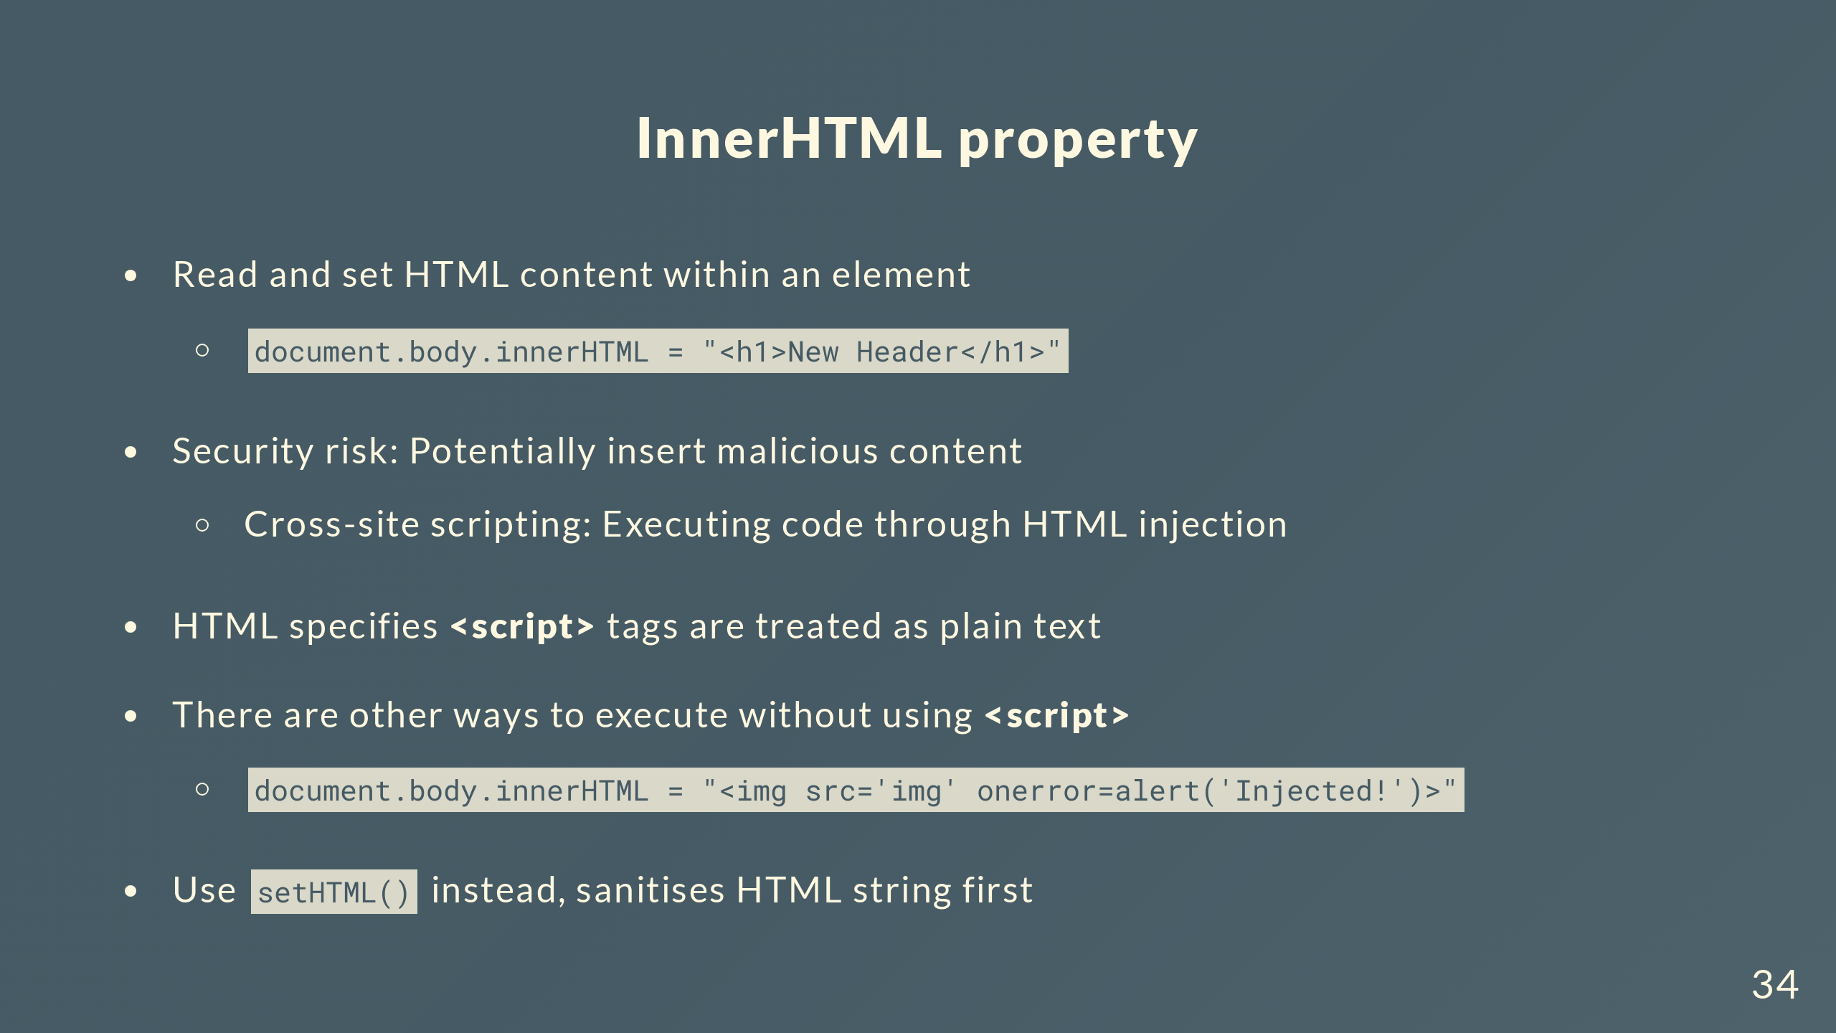
Notes:
If the image specified in the src attribute fails to load, which it does because “img” is not a valid URL, then the error event fires and executes the alert function

Slide 35
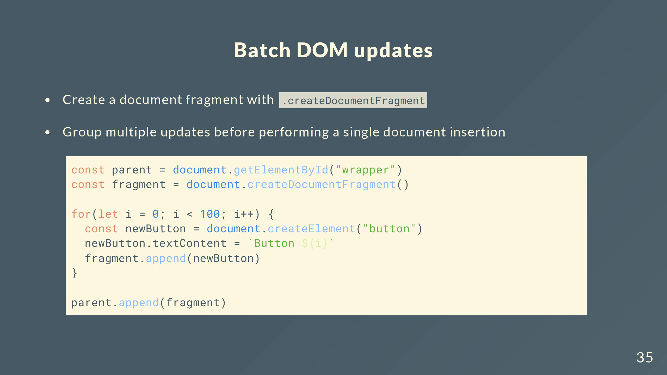
Notes:
If you want to perform multiple insertions to the DOM, you can batch them instead using DocumentFragment
It’s basically a lightweight document object that acts as a container. Though, it’s not active in the main DOM tree so when you add a node to it, there’s no side effects like browser reflows
At the end you can do a single insertion by attaching the fragment back into the DOM

Slide 36
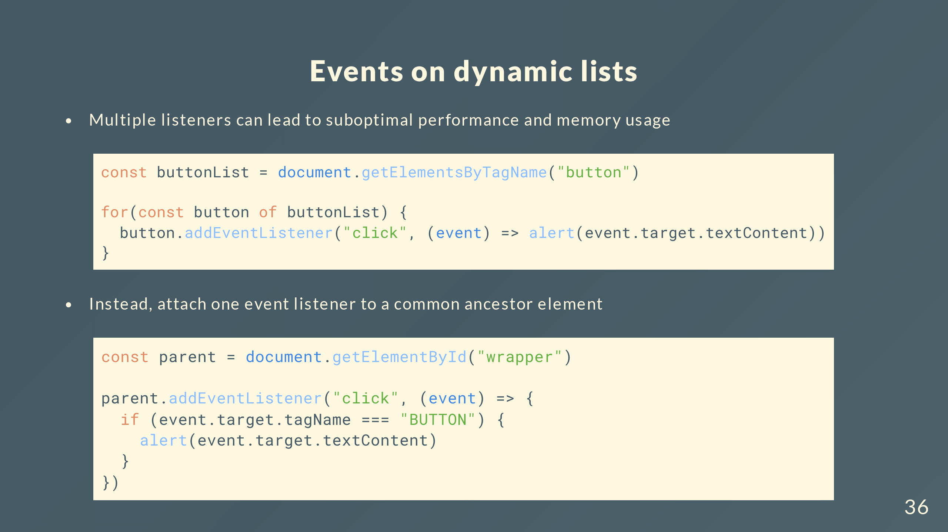

Slide 37
